Slide 1
MARCH 21, 2017

Slide 2
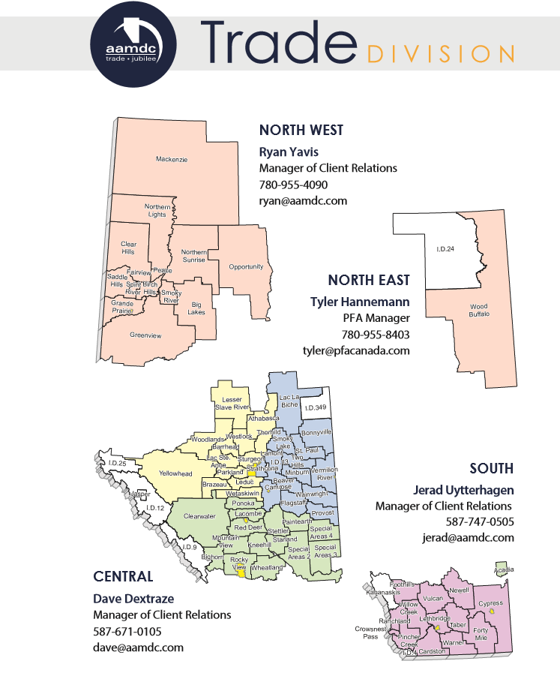
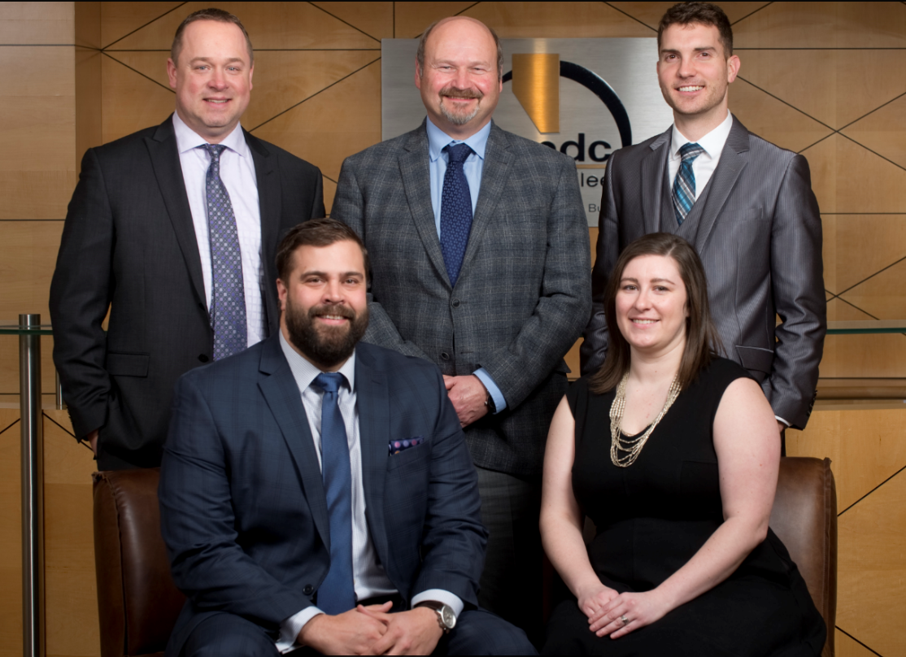
CLIENT RELATIONS MANAGERS
Map and pictures

Slide 3
AGGREGATED BUSINESS SERVICES
AAMDC.COM
AAMDC.COM

Slide 4
WHO ARE WE TODAY
Jubilee Insurance Agencies
PFA Canada – Over 60,000,000 Litres Annually
700,000 Litres Lubricants
Get your PFA analysis today
Trade Division
69 Members
Over 800 Associate Members
Over 120 Suppliers
$46,000,000.00 annually

Slide 5
SOME OF OUR SUPPLIERS
AAMDC.COM

Slide 6
Openly Tendered Programs (NWPTA)
In Place Today
AAMDC/NJPA
Caterpillar
Case New Holland
Fabric Shelter Program
Coverco
Grader Blade Program
Valley Blades
Wearpro Equipment
Shaw Enterprises
Energy Program
8760 Energy

Slide 7
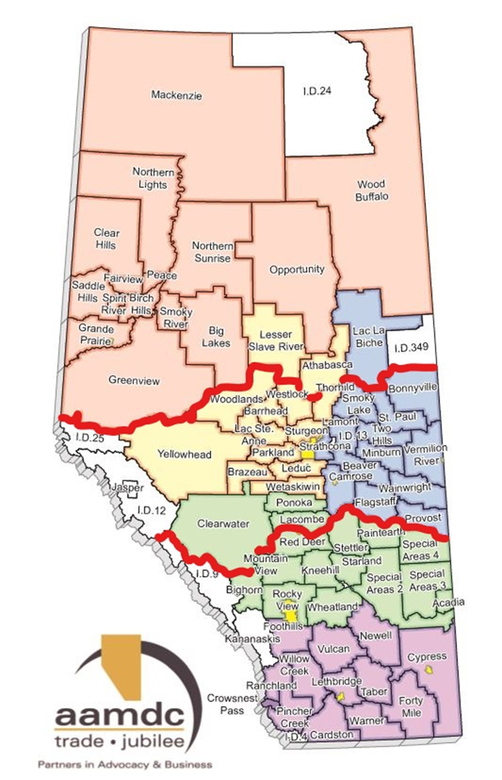
Openly Tendered Programs (NWPTA)
In Progress
Culvert Supply Program
Divided into 3 Service Areas
Based on Unit Cost for CSP
Based on Unit Cost for Shipping
Weed Control – Herbicide Supply Program
What's Next
Dust Control
Salt for snow and Ice Control
????

Slide 8
AAMDC/NJPA
Participation
4 Municipalities in 2015
16 Municipalities in 2016
Total sales of $11,541,613.17 to the end of 2016
Manufacturers Currently on the Program
Caterpillar
Case New Holland
What's Next
Meeting in May with Manufacturers – John Deere, Volvo, Firetrucks, Fleet

Slide 9
TRADE ADVISORY COMMITTEE
The Trade Advisory Committee is structured as a way for individual Trade Division members to share their opinions and perspectives, issues, and develop recommendations in a focused, small group structure. The Advisory committee meets quarterly and consists of representatives of each of the following groups:
2 AMSA Members | Bill Cade – Lacombe County (Chair) & Joe Duplessie – Lac Ste. Anne County
2 Urban Associate Members | Bob MacNeil – City of Grande Prairie & Kurtis Pratt – Town of Raymond
1 ARMAA Member | Sheila Kitz – County of Saint Paul
1 Non-Urban Associate Member | Vacant
2 Approved Supplier Members | Jeff Nichol – Lane Quinn Benefit Consultants & Theresa Koetsier – Corix Water Products
AAMDC Staff Members

Slide 10
THE RESULTS
Quality Product
Acquisition Cost
Product Availability
Warranty
Total Cost of Ownership
Distribution Location
Brand/Distributor Reputation
Payment Terms

Slide 11
WHAT YOU TOLD US
Quality is most important because it affects every other item.
Availability comes first when we need product. It usually is needed now. Cost is last. Downtime costs more in the long run.
With limited budgets and Risk adverse councils, cost is key.
Service after the initial purchases.
If I buy tires and they are shot after 30 or 40 K I am not happy even if they are half the price.
The order very much depends on what the product is. Distributor location is extremely important for fuel for example, but not important for oil filters.

Slide 12
WHAT YOU TOLD US
Warranty, keep costs down. Quality, reliable products. Brand Reputation, well known for products.
Fuel side of things are great. Lubricants - have issues with availability of product. Turn around time with delivery and invoicing.
Using local vendors with the trade division is important.
We are very value driven with a strong emphasis on local supplier support.
Availability is very high because we are so far north. Would like to see more brand to choose for light truck and SUVs.

Slide 13
WHAT ARE WE DOING ABOUT IT
More in-depth Membership Survey
Trade Advisory Committee
Creating New Openly Tendered Programs
Increased to 3 Managers of Client Relations from 2
Increasing Associate Members to Bolster Buying Power
Website Update- Digital Access to Pricing

Slide 14
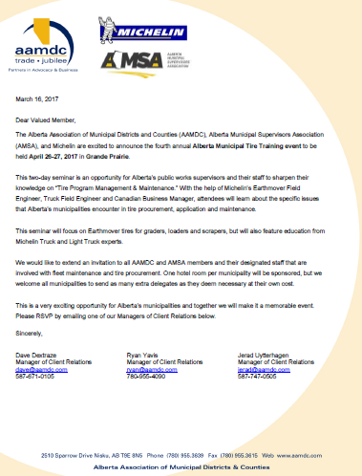
UPCOMMING EVENTS
Tire Training / Plant Tours
NJPA Presentations
Golf Tournament
?

Slide 15
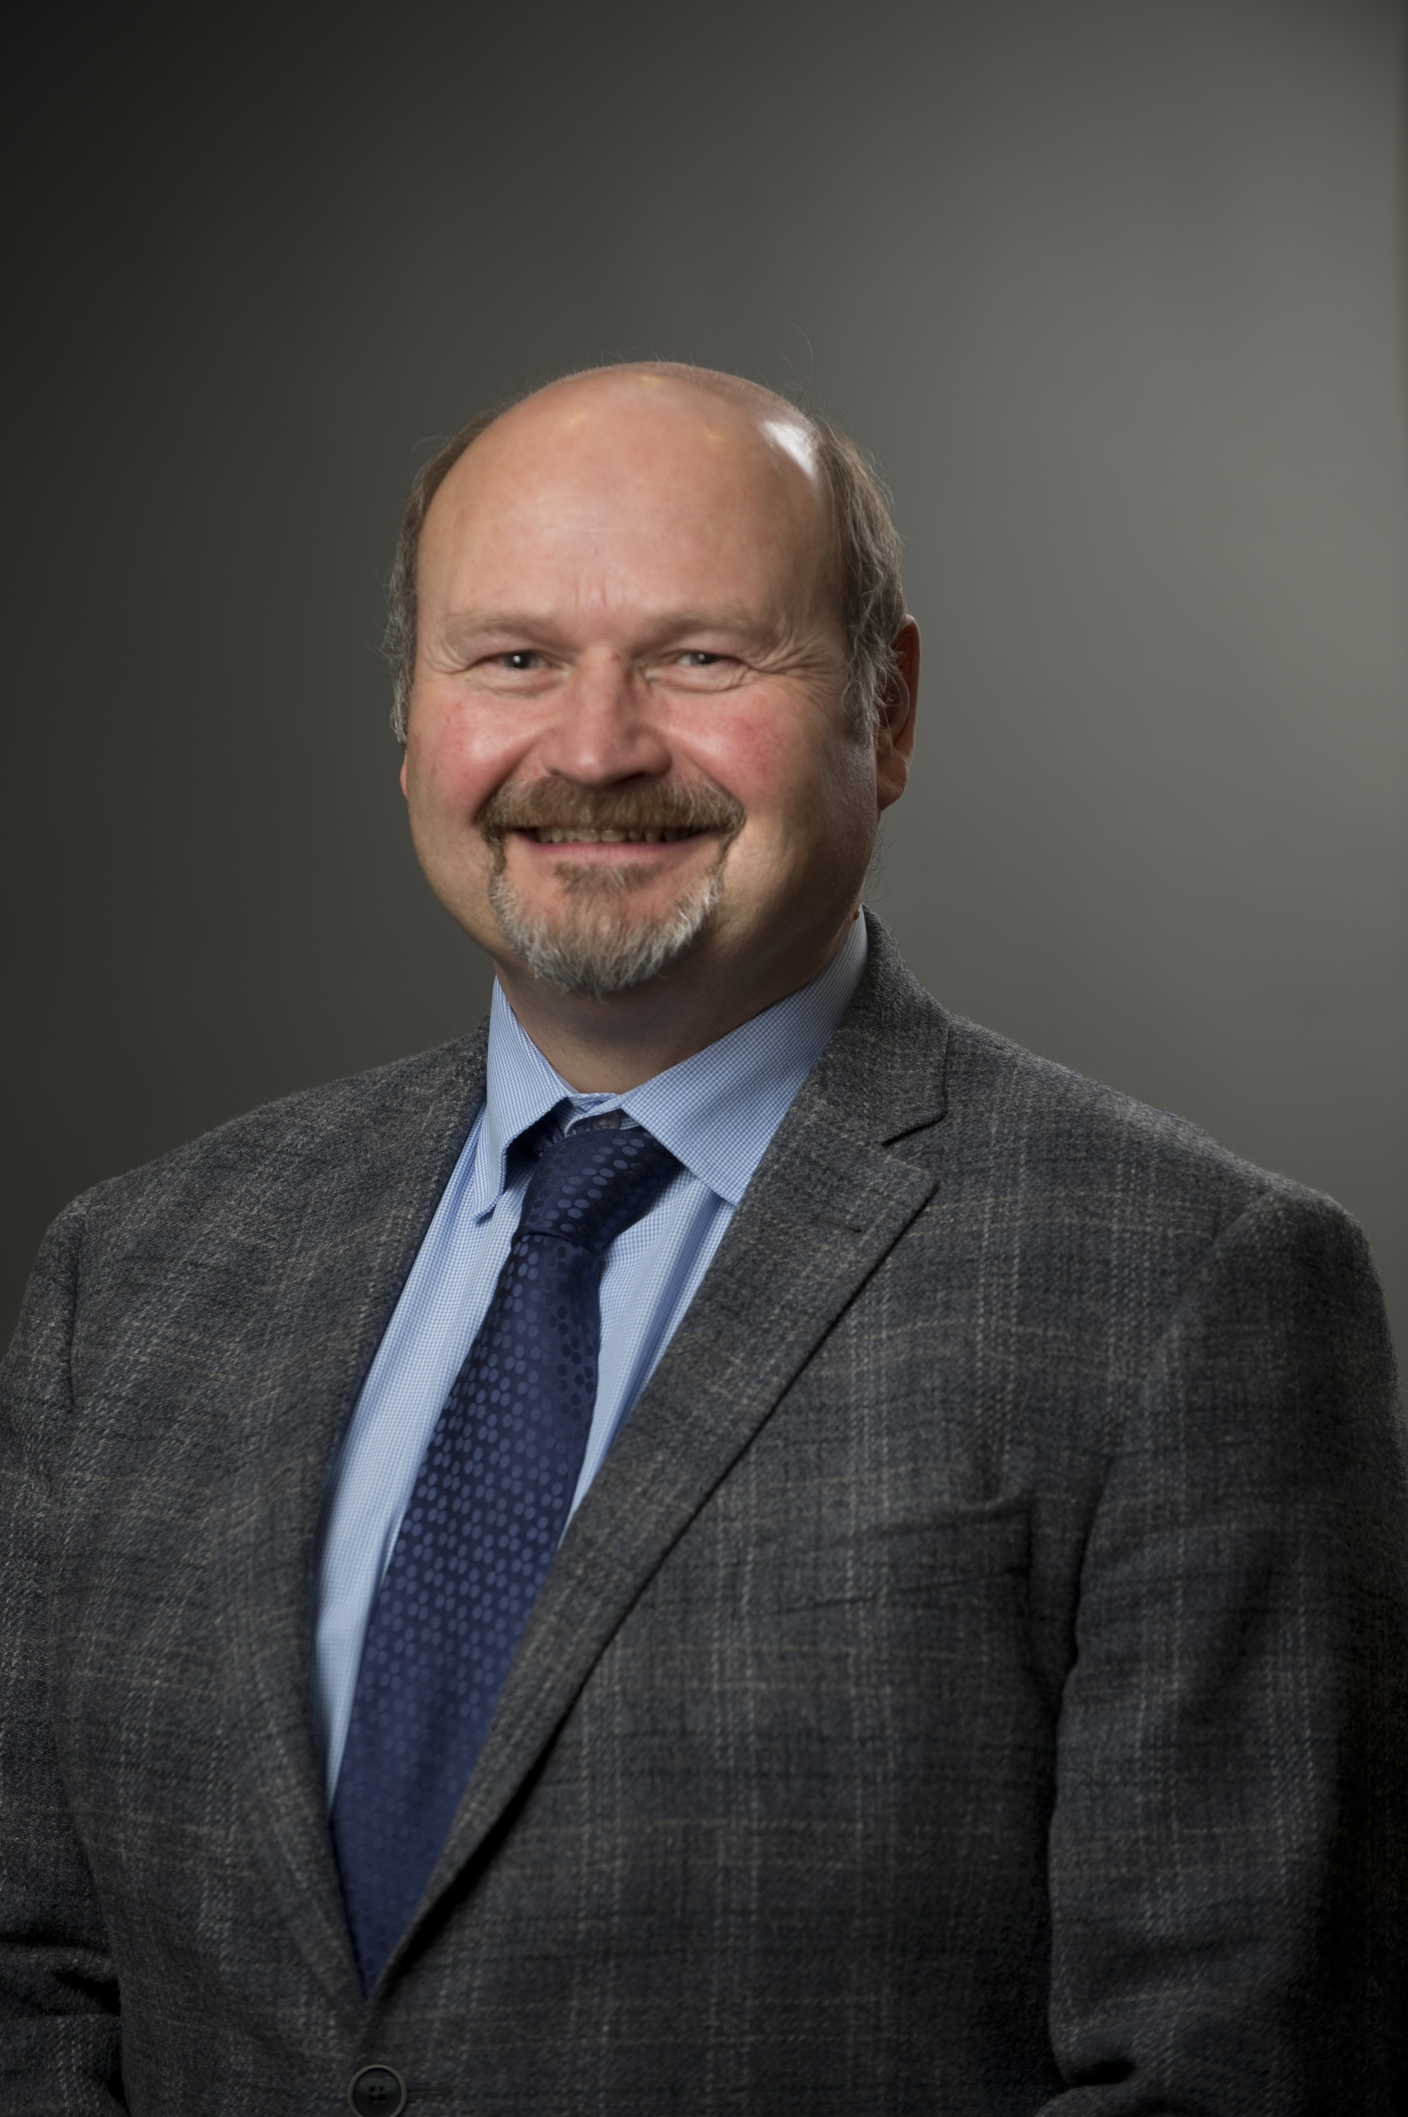
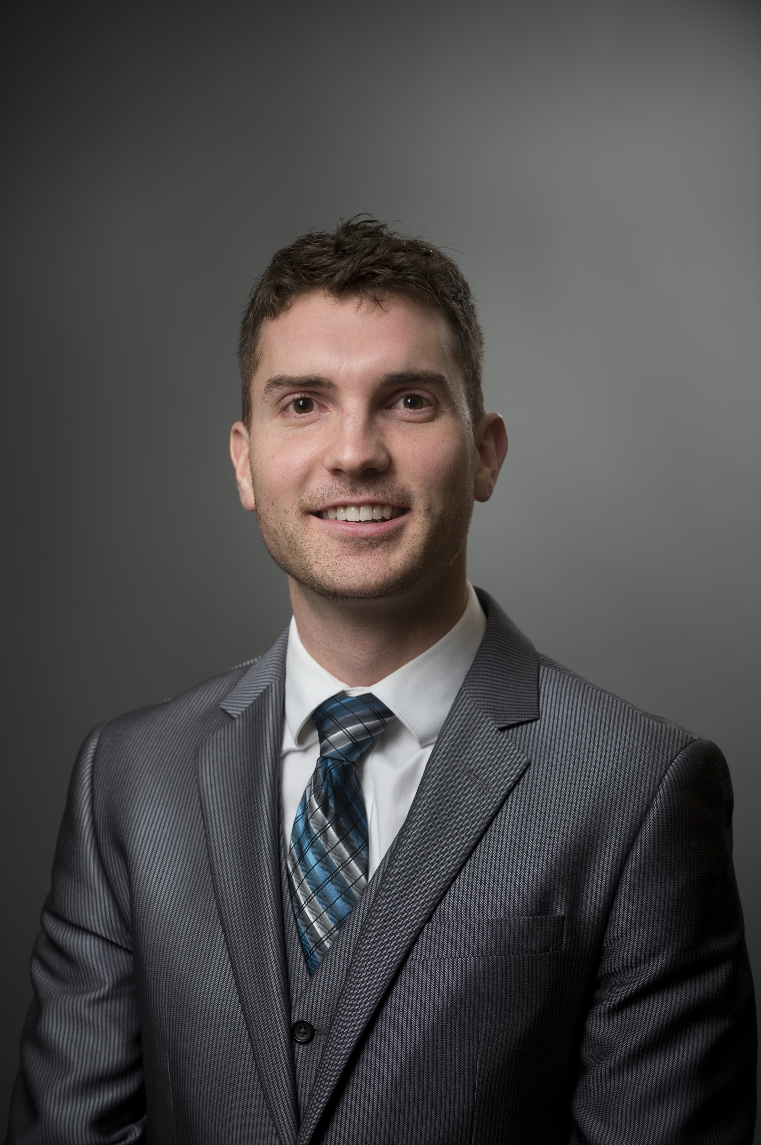
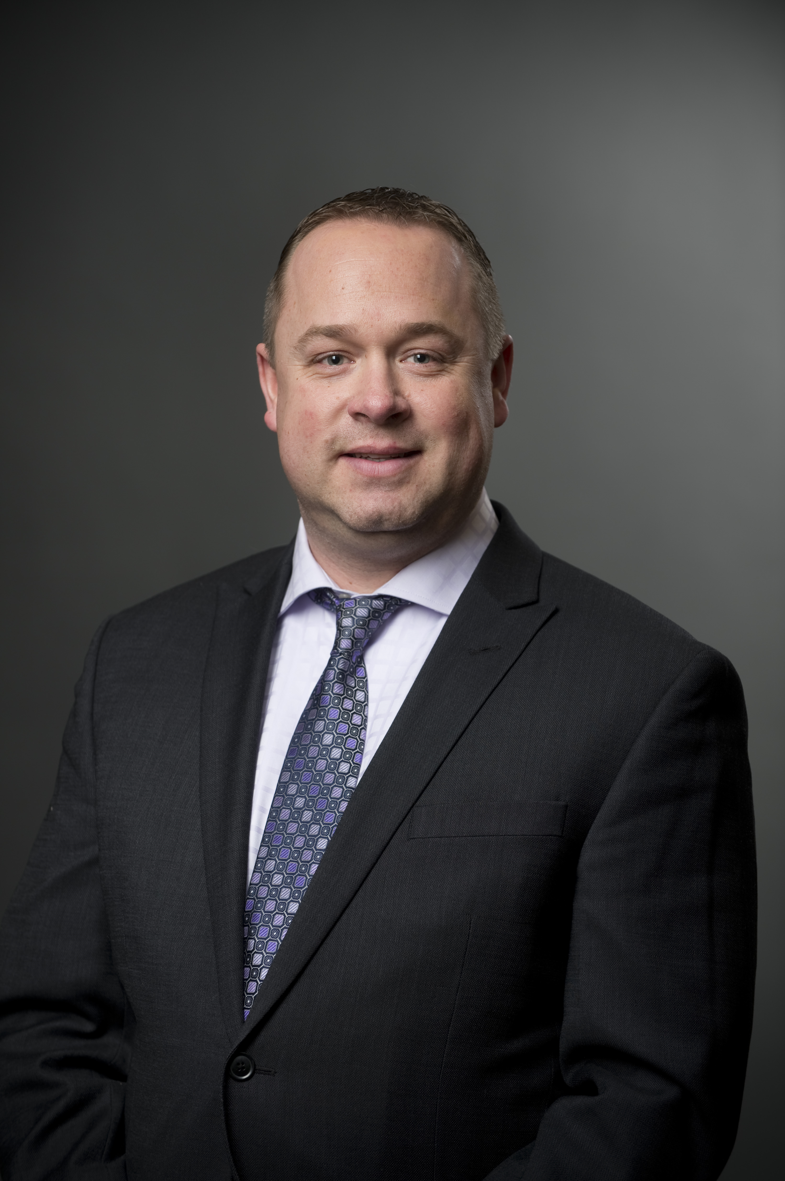
Questions
For more information, please contact:
Dave Dextraze C.E.T. Manager of Client Relations dave@aamdc.com 587-986-4189
Jerad Uytterhagen Manager of Client Relations jerad@aamdc.com 587-747-0505
Ryan Yavis
Manager of Client Relations ryan@aamdc.com 780-720-5145

Slide 16
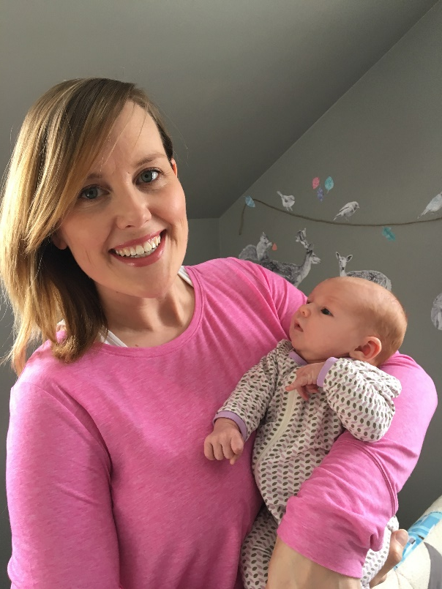
Carolyn Caldwell Manager of Client Relations & Trade (On Leave)

