Slide 1
MRF Web Map Update
MRF Geosystems Corporation
Jing Wang
Nov 24, 2021

Slide 2
MRF Web Map Platform
Proud to serve over 50 municipalities in Alberta
Planning
Document Management
Routing
Asset Management
Inspection
Asset Tracking
LiDAR View
Web Map
Work
Alone
Emergency
Notification
Field Map
Data Collection

Slide 3
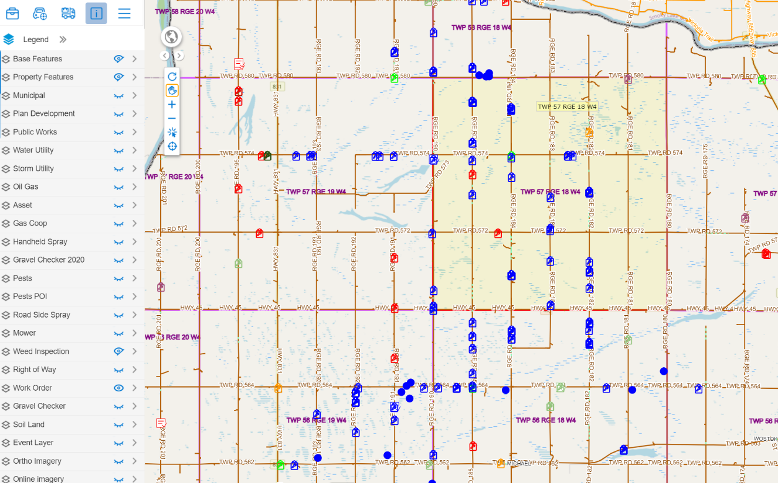
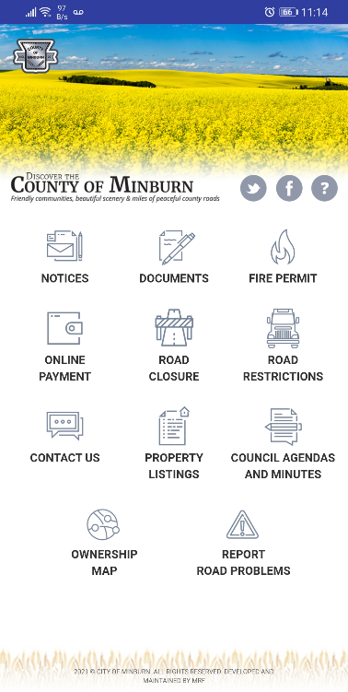
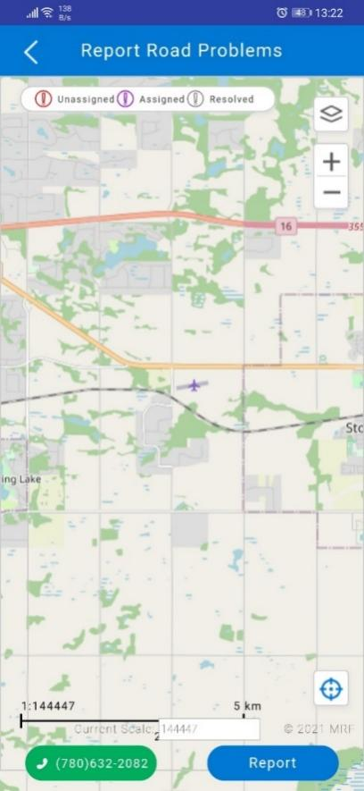
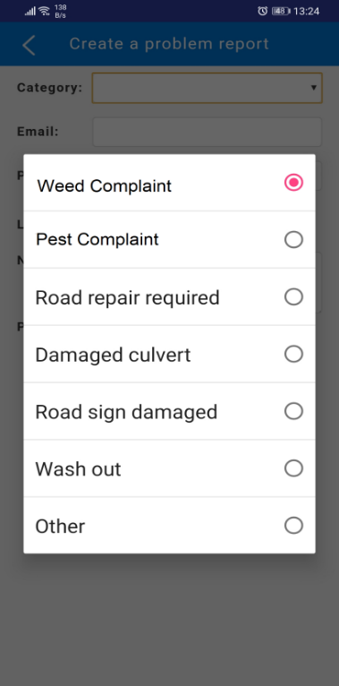
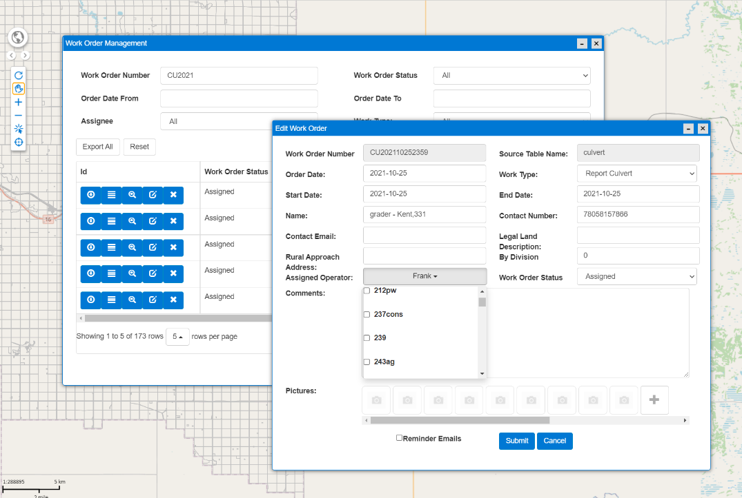
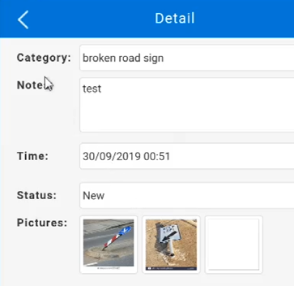
Citizen Report App and Work Order
County of Minburn and Beaver County are using it
Submit Complaints/ Work Orders
Staff Review & Assign Complaints /Work Orders
Field Worker Process Task List
Supervisor Review and Close Tasks

Slide 4
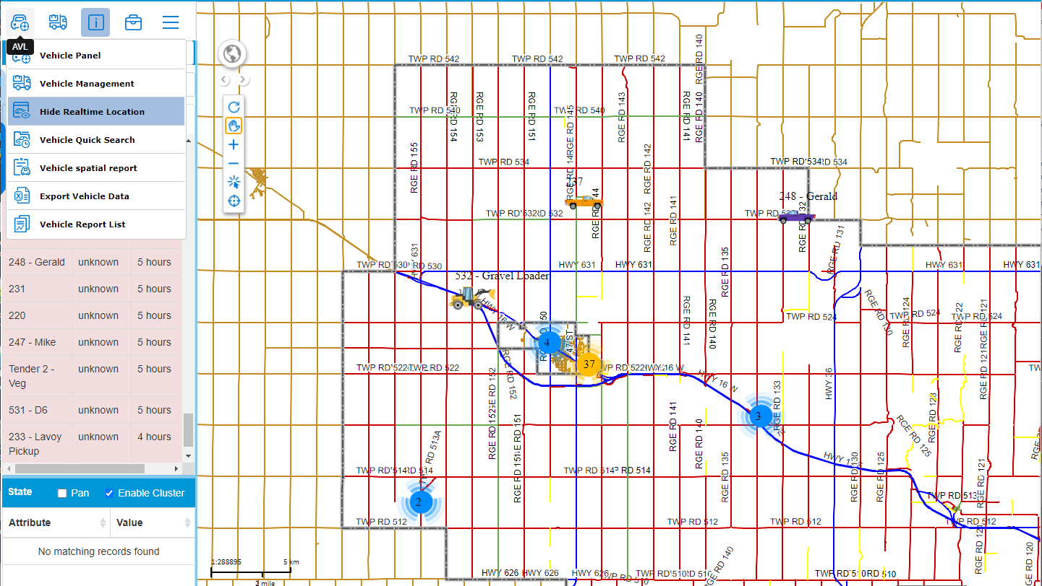
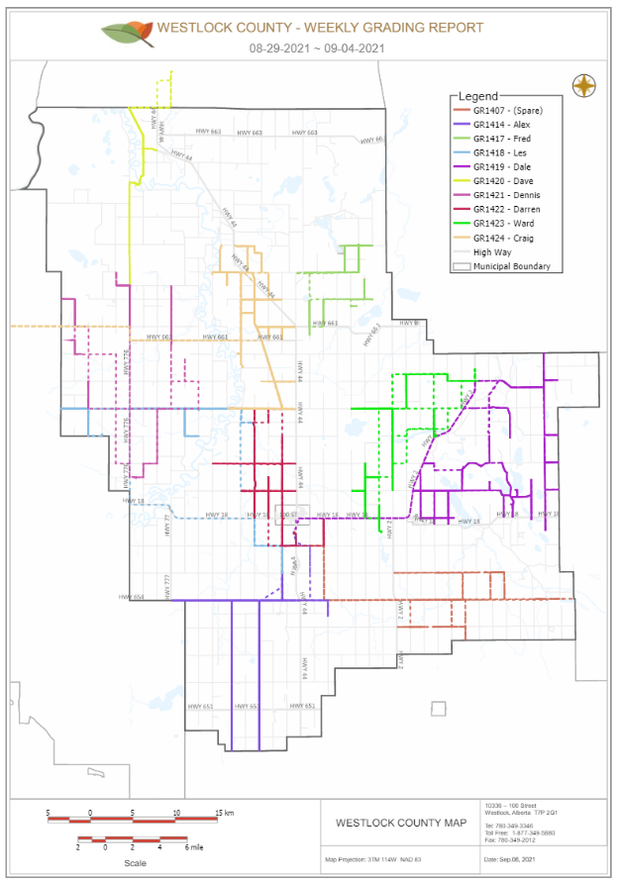
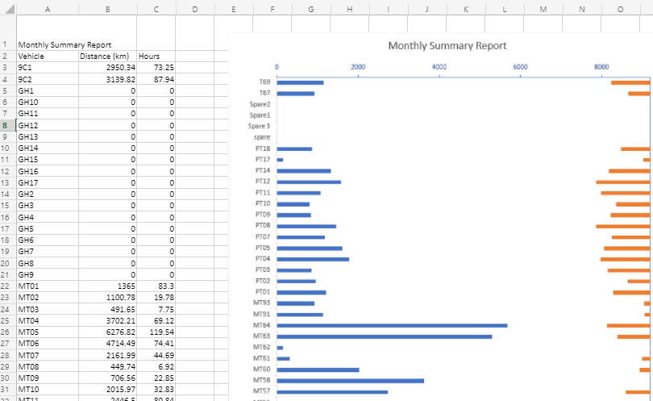
Vehicle Tracking
Real-time location
Spatial History Search
Customized Report

Slide 5
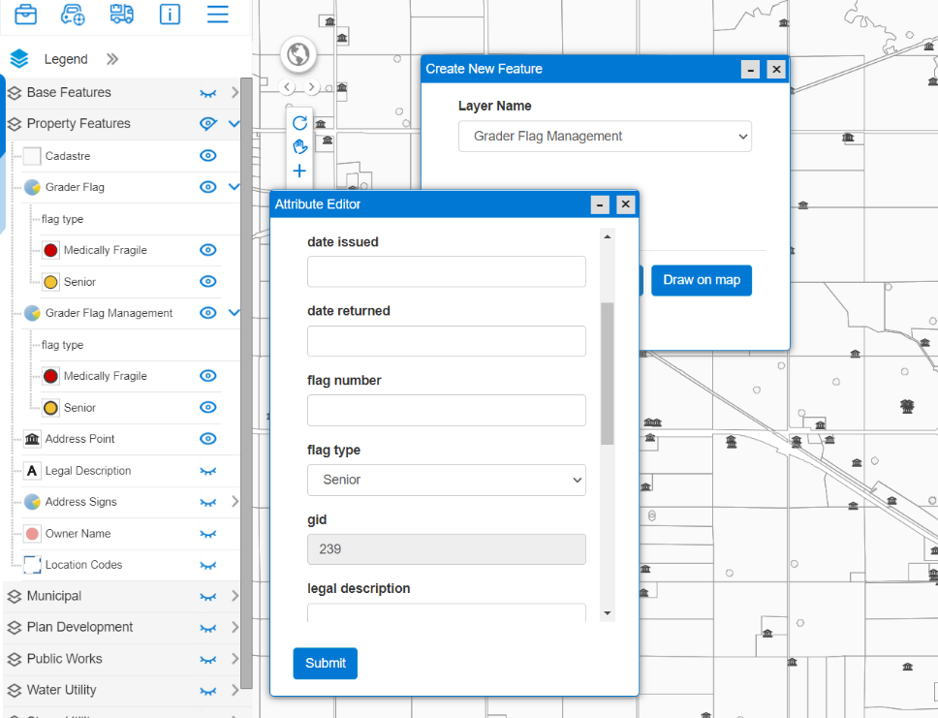
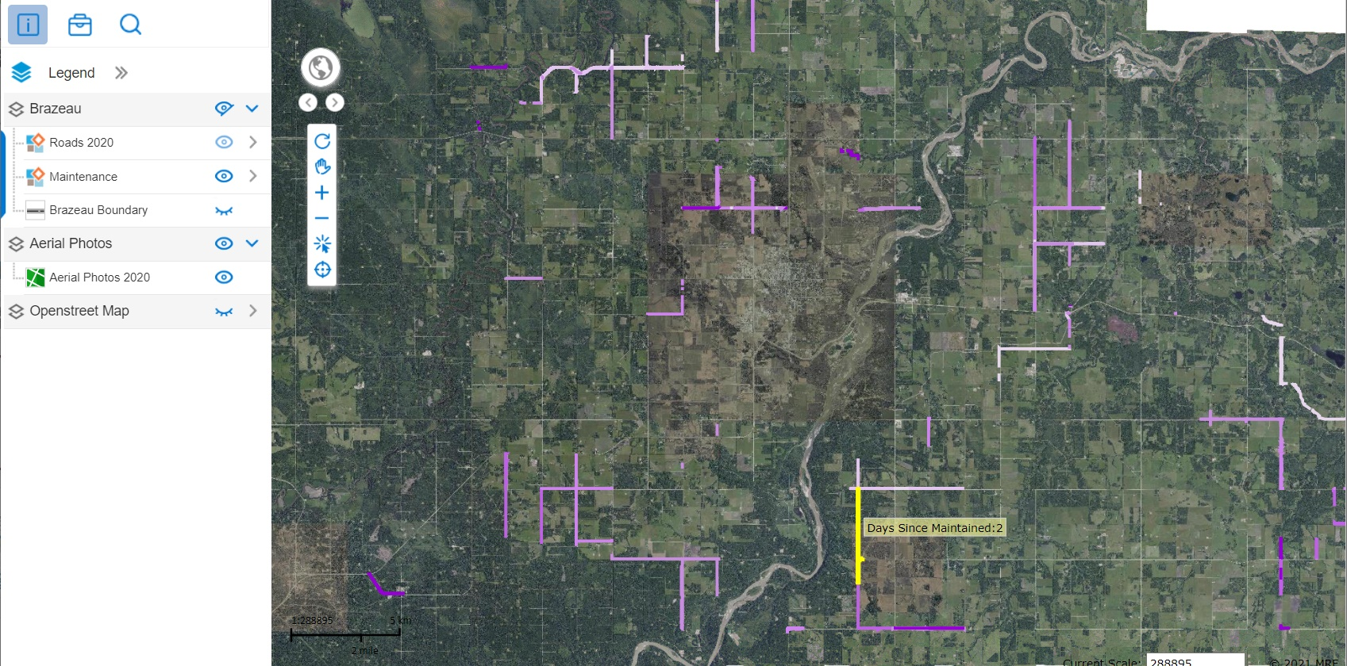
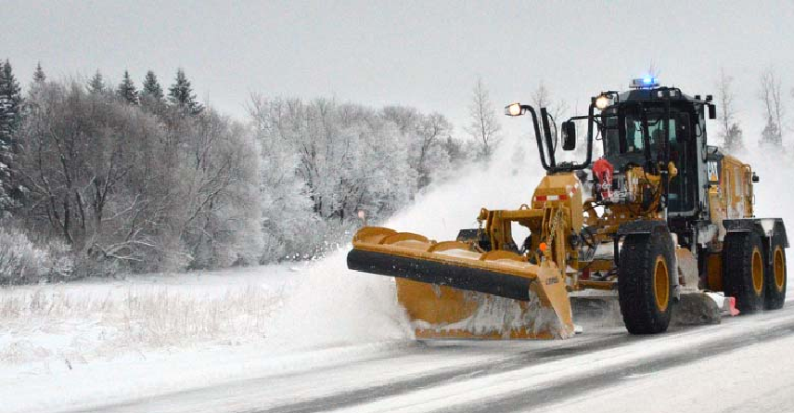
Snow Maps
Road Maintenance/Snow removal Map
Snow Flag Management
Lamont County and Brazeau County

Slide 6
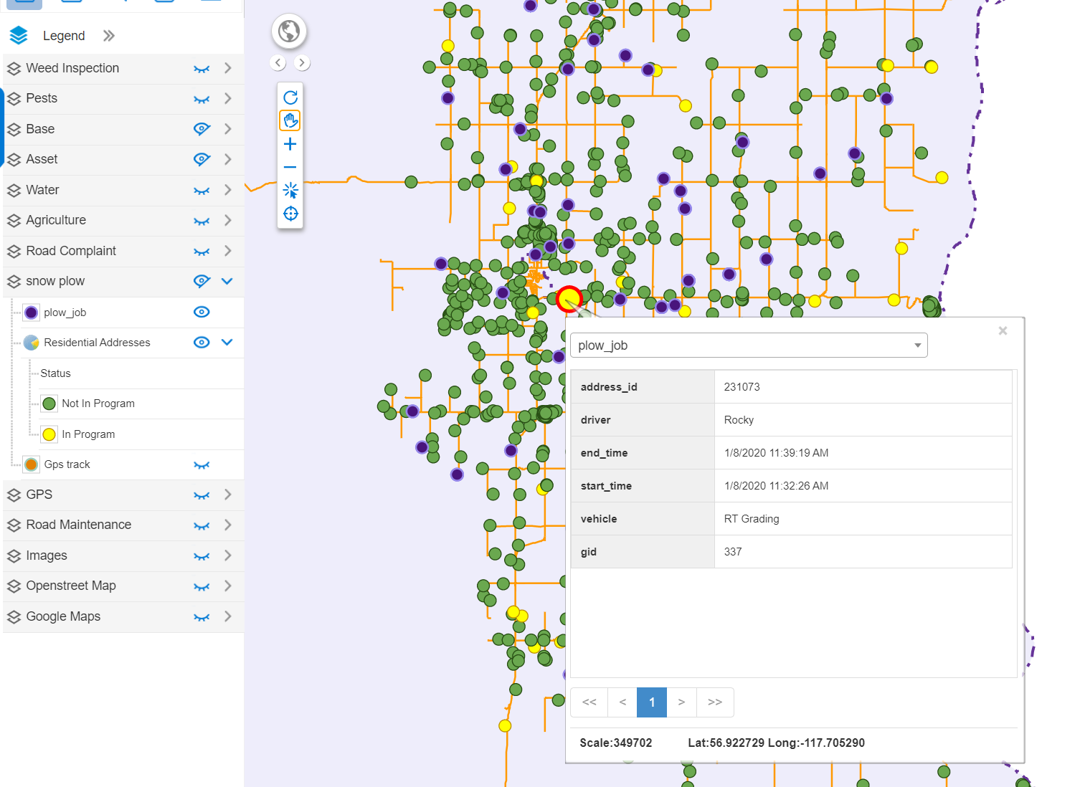
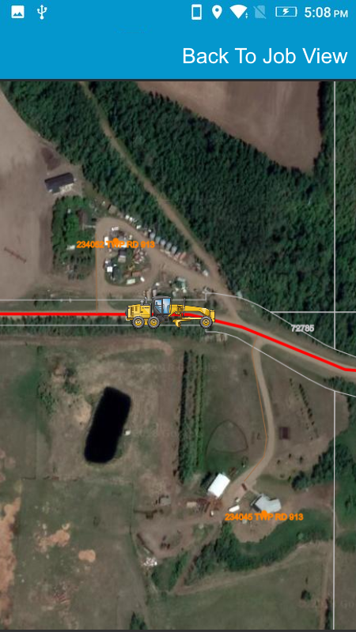
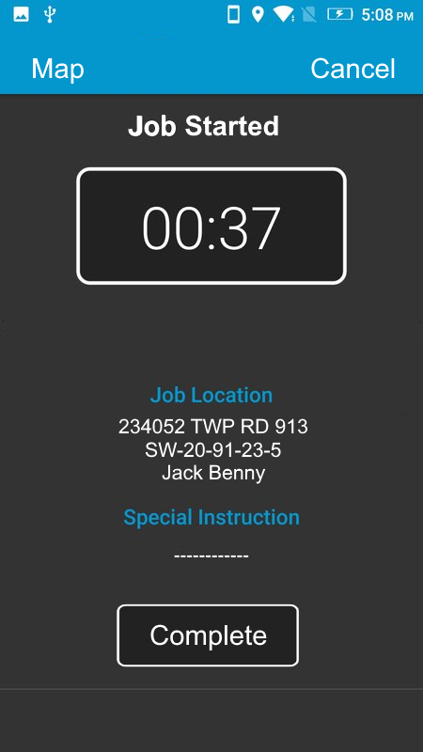
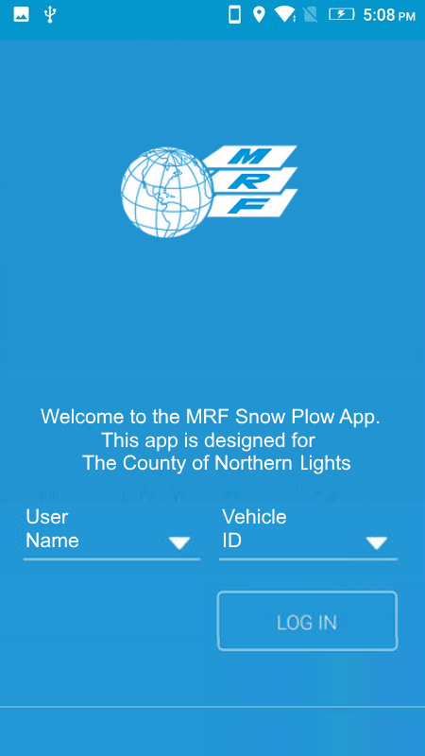
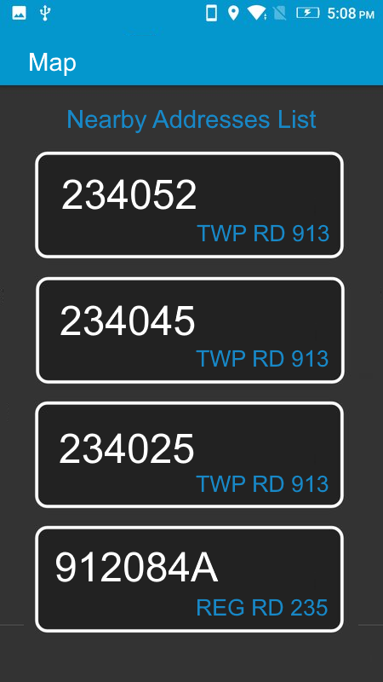
Snow Maps
Snow Plow Job App
County of Northern Lights

Slide 7
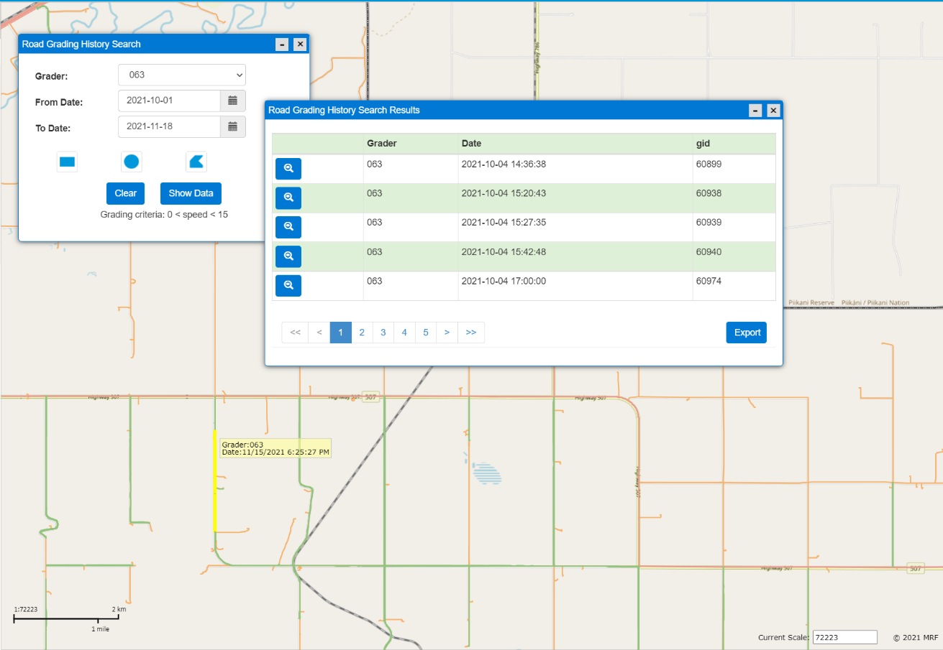
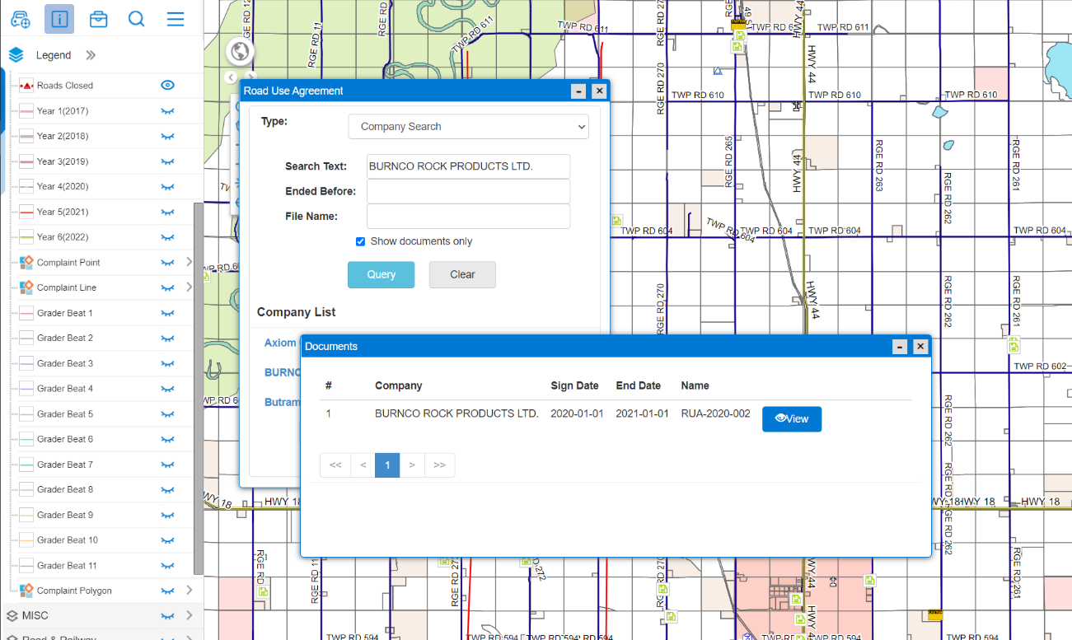
Roads and Public Works
Road Use Agreement Management
Grader History Search

Slide 8
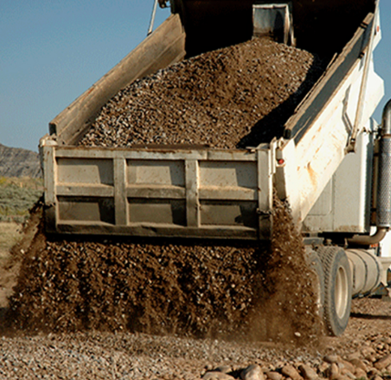
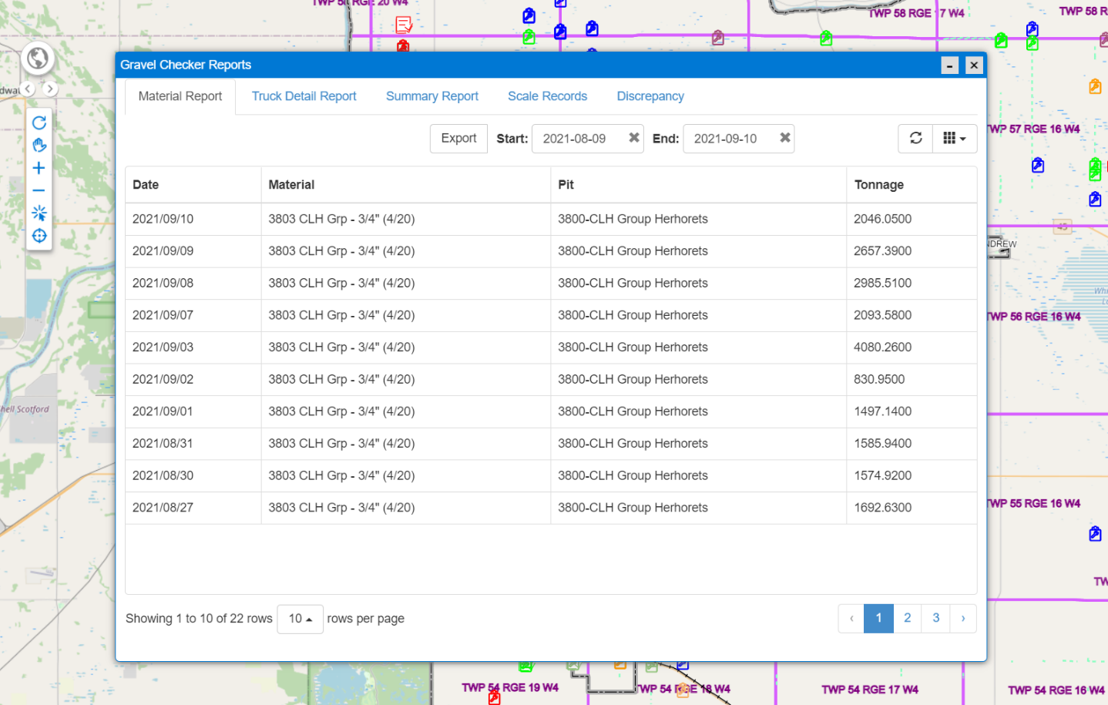
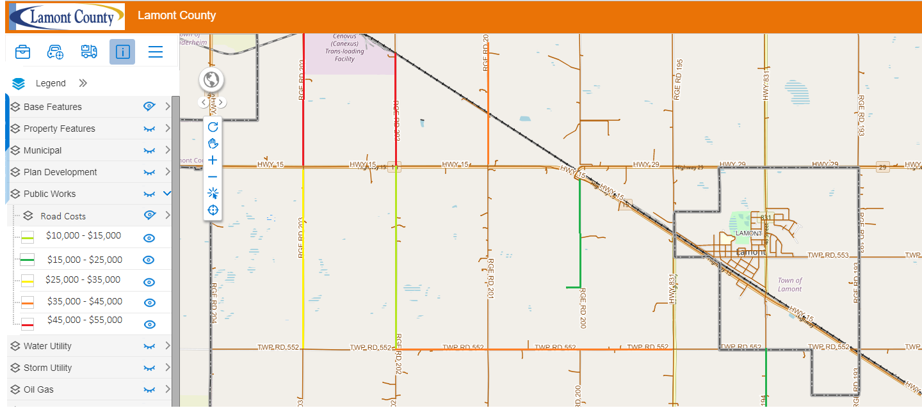
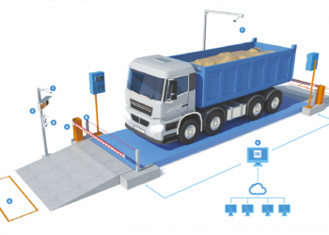
Roads and Public Works
Gravel Checker with Ticket
Lamont County, MD of Minburn are using it
MD of Greenview iOS Gravel Reporting App is under development

Slide 9
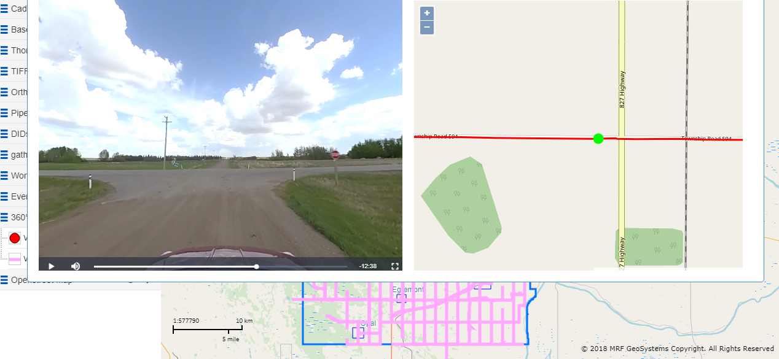
Roads and Public Works
360° Road Video
Thorhild County, Clearwater County and MD of Bonnyville are using it.

Slide 10
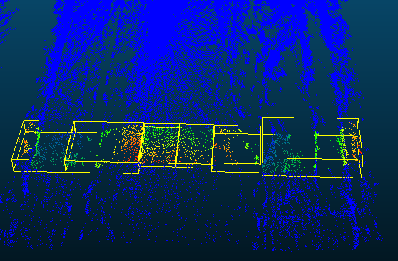
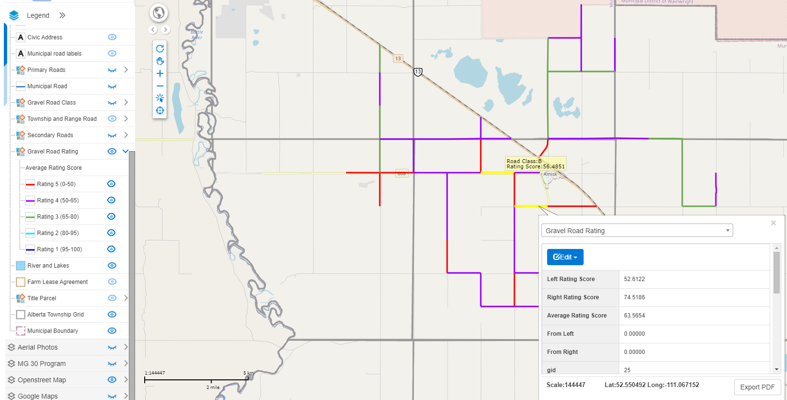
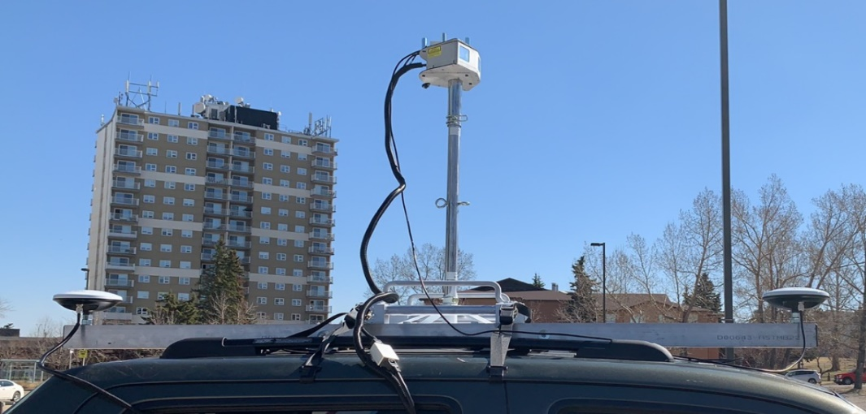
LiDAR-based gravel road condition assessment
Assign a rating based on the LiDAR scanning result score
MD of Provost and MD of Pincher Creek have done it.

Slide 11
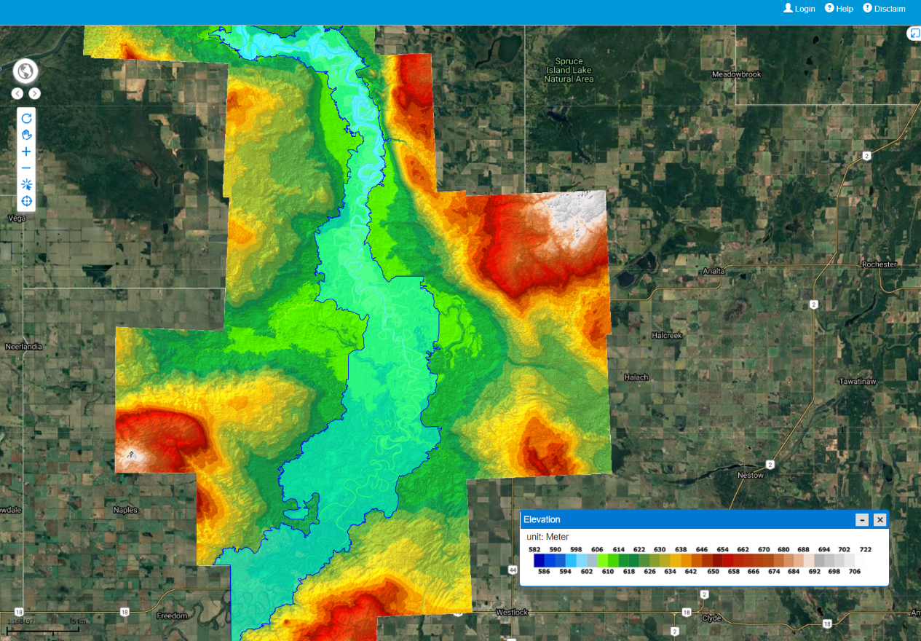
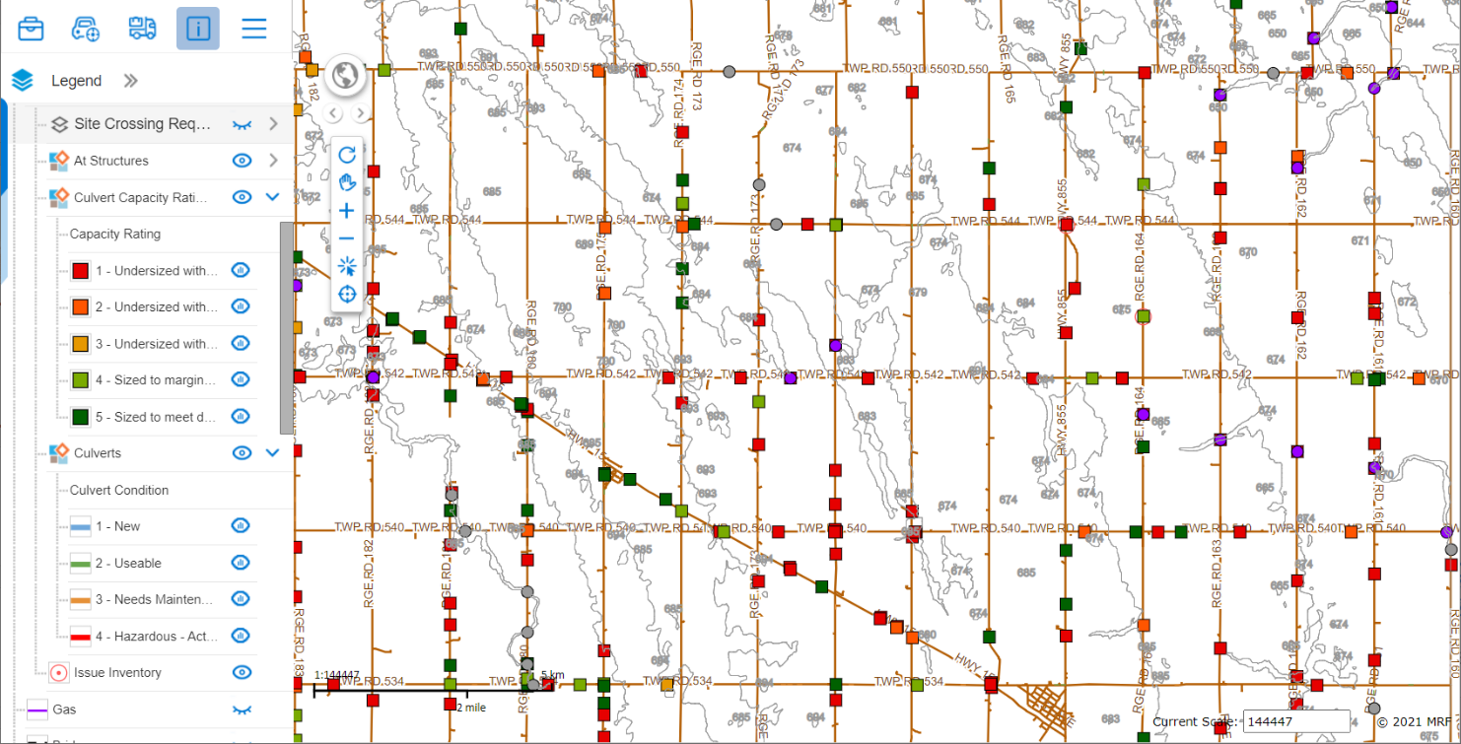
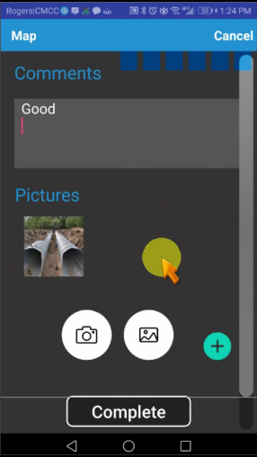
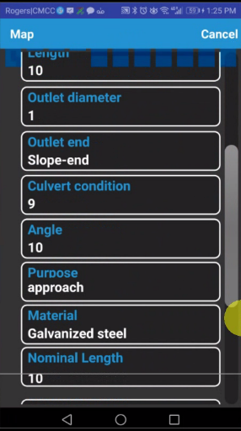
Culvert Condition Assessment
Drainage Analysis
Flood Zoon Analysis
Watershed Modelling

Slide 12
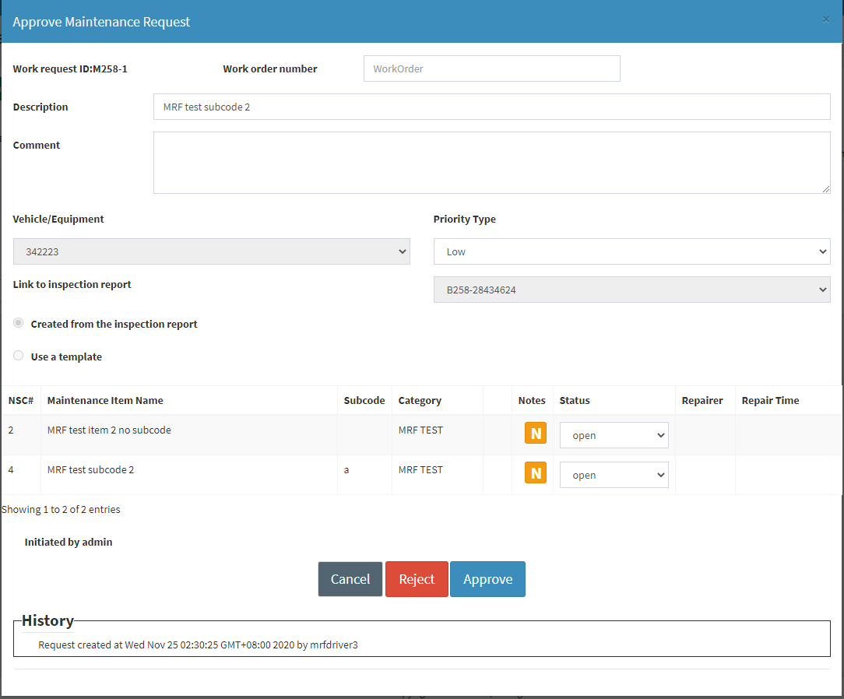
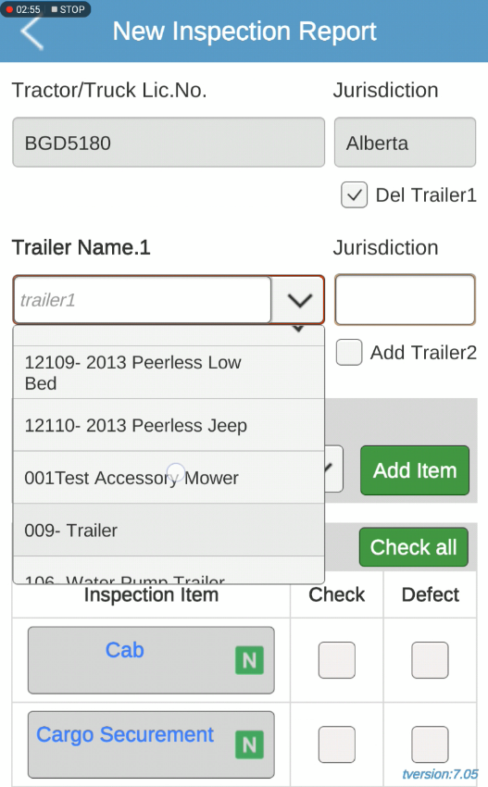
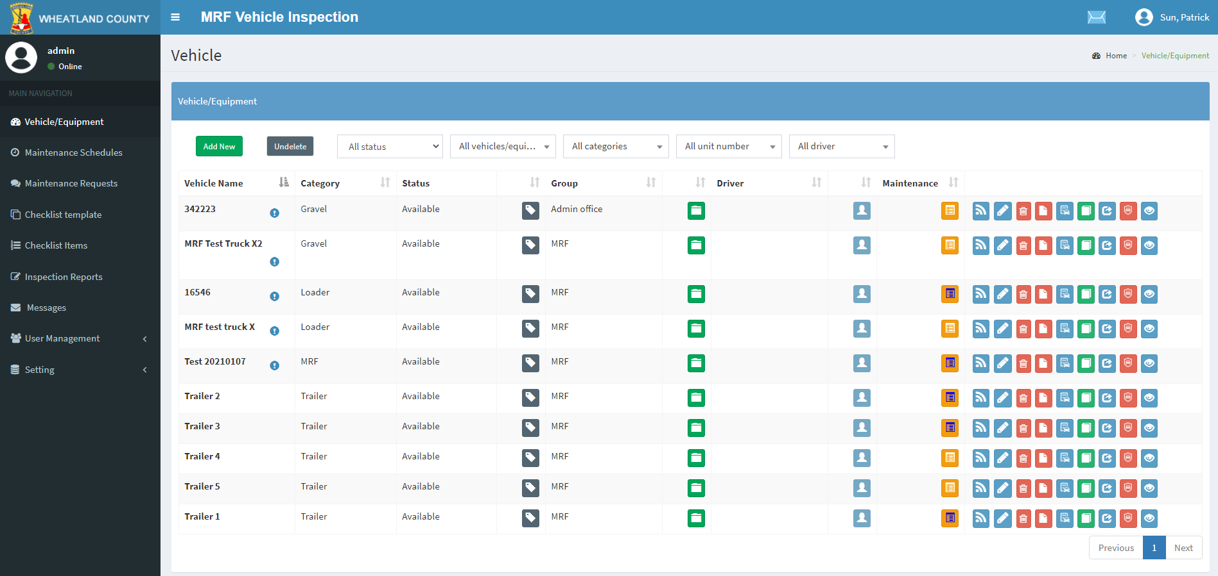
Vehicle Inspection
Wheatland County and Lac La Biche County are using it

Slide 13
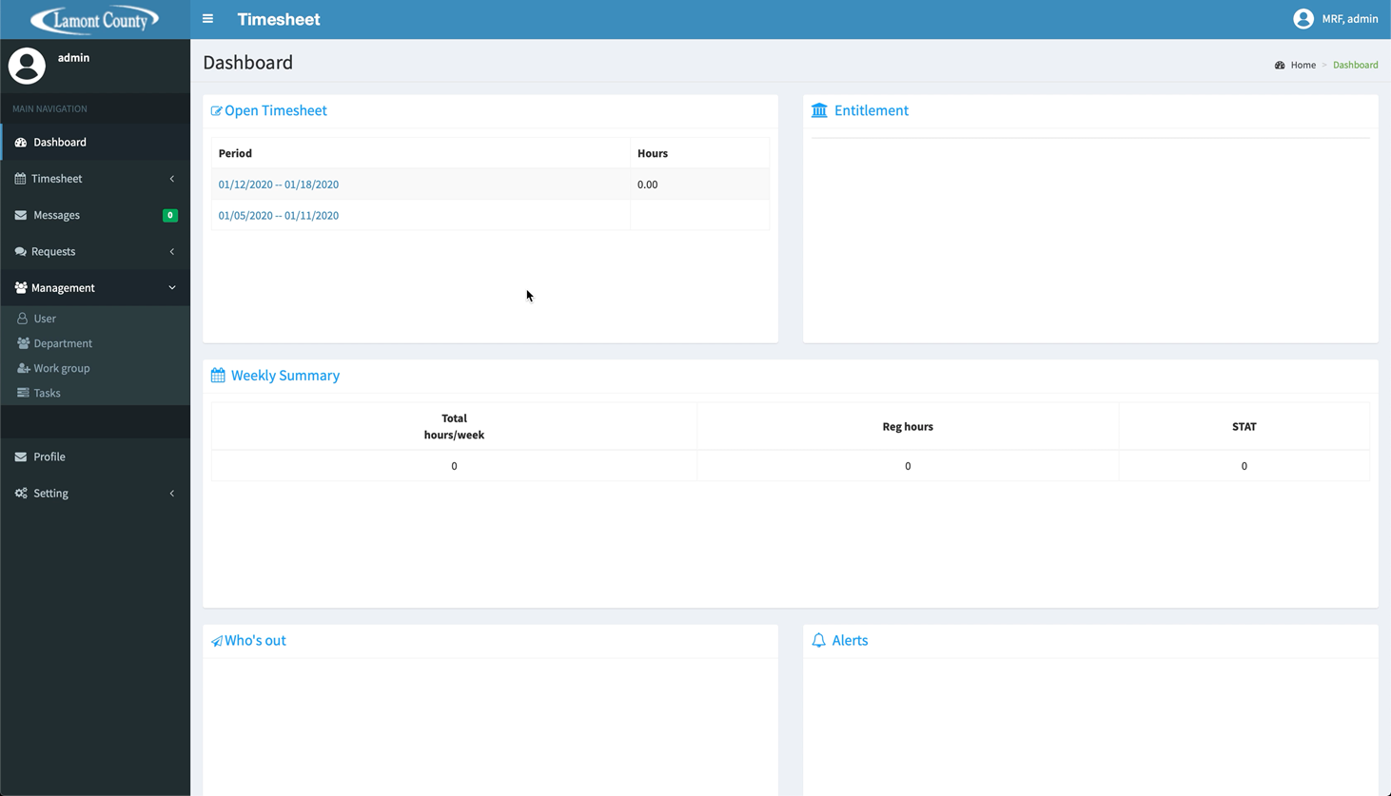
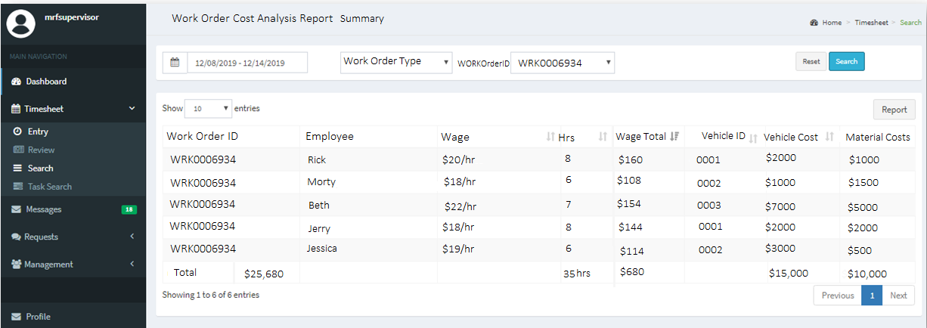
Timesheet
Lamont County is using it

Slide 14
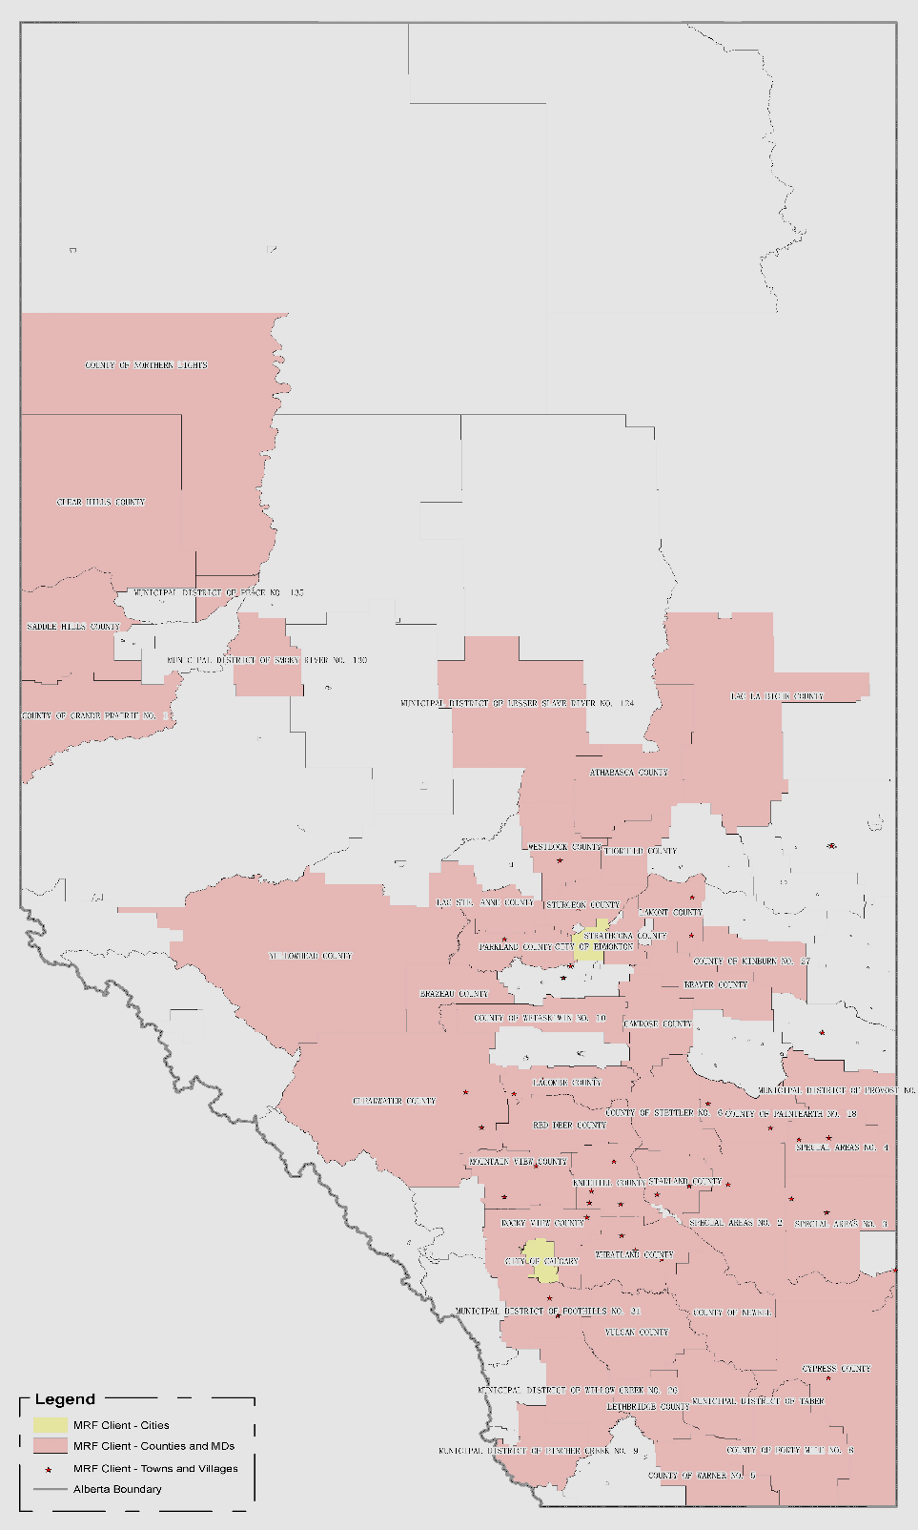
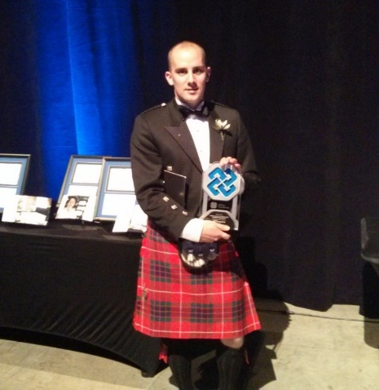
Why MRF
MRF Municipal Customers in Alberta
A strong motivated GIS team
Industry-leading GIS Technologies
25+ yr North American GIS industry experience
An excellent track record of customer satisfaction
MRF awarded by Alberta Science and Technology Leadership (ASTech) Foundation

Slide 15
Thank You
MRF Geosystems Corporation
Drop your business card and winners will be announced at lunchtime.

