Slide 1
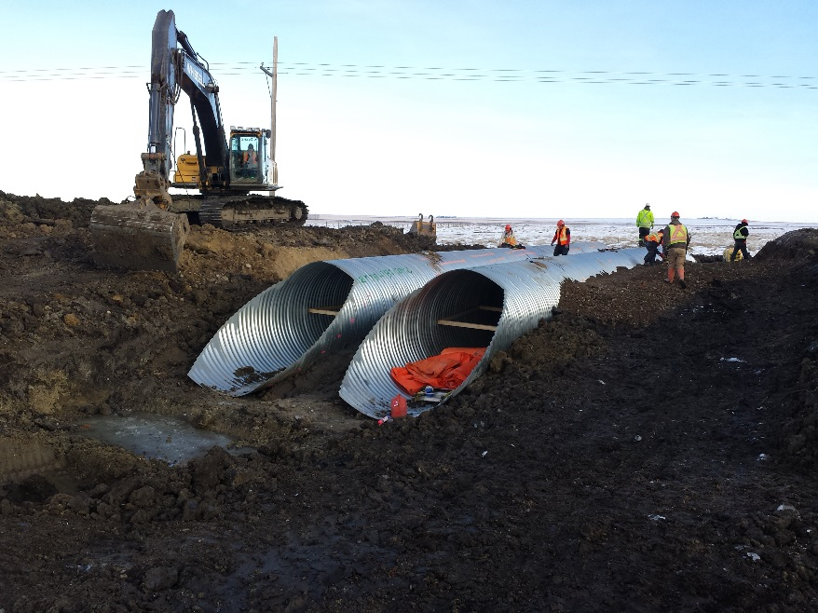
Bernie Roseke, P.Eng., PMP
President
Roseke Engineering Ltd.

Slide 2
What I will Talk About
A few innovative things we do
Project management
Proposal price list
Contractor relationships
A real project

Slide 3
Company Overview
Specialize in County/M.D. bridges
Bernie Roseke has been a bridge engineer for 16 years. He has designed every type of standard bridge and culvert structure: CSP, SPCSP, Open bottom culvert, concrete pipe, concrete box, type SL, SLW and SLC standard bridges
Levi Ober, P.L.(Eng.) has 13 years of experience in the design and construction of standard bridges and culverts. He is a class B BIM inspector

Slide 4
Services
If it involves a County bridge file, we can do it!
BIM Inspection
Planning / Assessments
Preliminary Engineering
Design
Tender Preparation
Construction Supervision
Final Details

Slide 5
Project Management
All projects are managed by a certified Project Management Professional (PMP)
Project schedules are approved in advance by the project sponsor
On a weekly basis, earned value reports tell the project manager the current schedule and budget status. These can be requested by the project sponsor anytime.
Changes to the project schedule are requested in writing.

Slide 6
Proposal Prices
BASE COST
2400 mm and under CSP – County Installed $22,500
2400 mm and under CSP – Tendered $30,100
Greater than 2400 mm CSP $44,000
Standard Bridge $83,700
ADDITIONAL ITEMS
QAES Assessment $4,900
Geotechnical Assessment $15,100

Slide 7
Relationships with Contractors
“Common Sense on the job site” results in some excellent benefits
Prices go down down
Better quality work
Better County/M.D. reputation

Slide 8
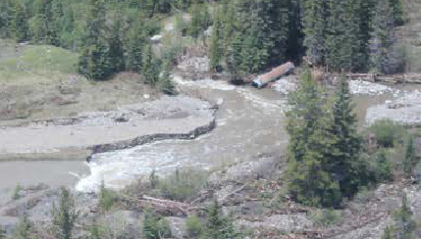
Etherington Creek Culvert Replacement

Slide 9
Etherington Creek Culvert Replacement
Featured in Roadrunner Magazine (Page 40)
Existing was 1 – 1200 mm diameter CSP
Replacement was a 7301 mm x 1743 mm Corrugated Aluminum Structural Plate Open Bottom Culvert on Cast-in-Place footings
Owner is Alberta Environment & Parks

Slide 10
Etherington Creek Culvert Replacement
First Step: Give the client a schedule

Slide 11
Etherington Creek Culvert Replacement
Rigorous environmental requirements
Full time turbidity monitoring
Silt free detour channel (actually, silt free everything!)
7 page report submitted at every unexpected siltation event (which was twice)

Slide 12
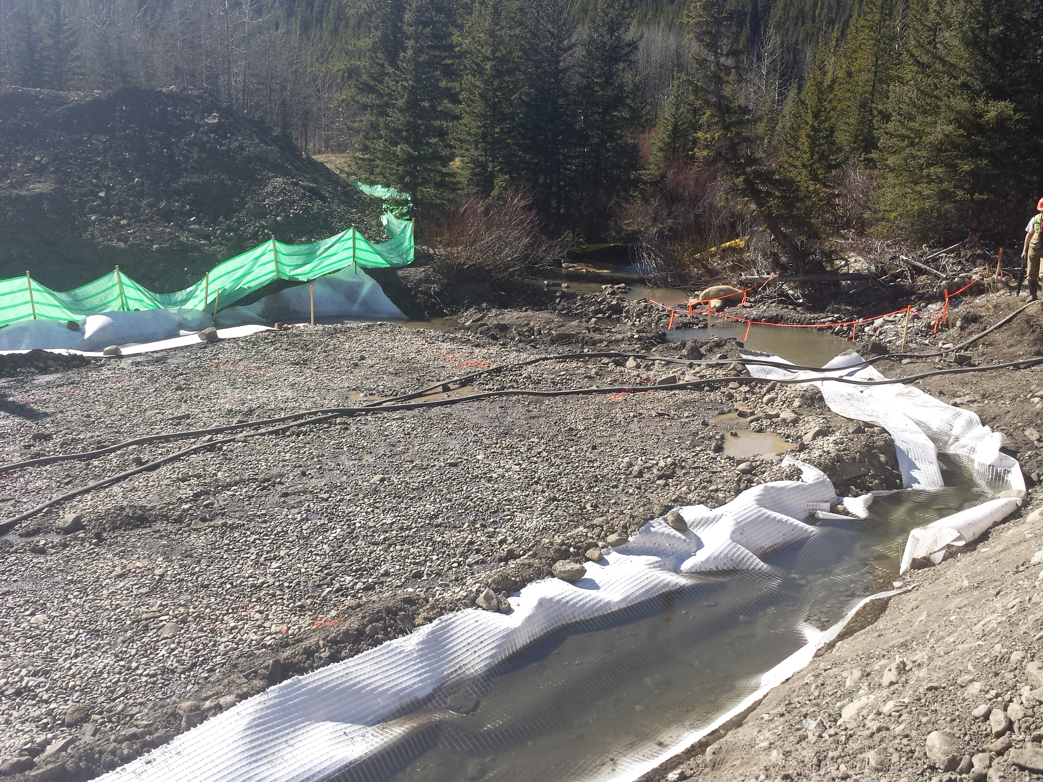
Etherington Creek Culvert Replacement

Slide 13
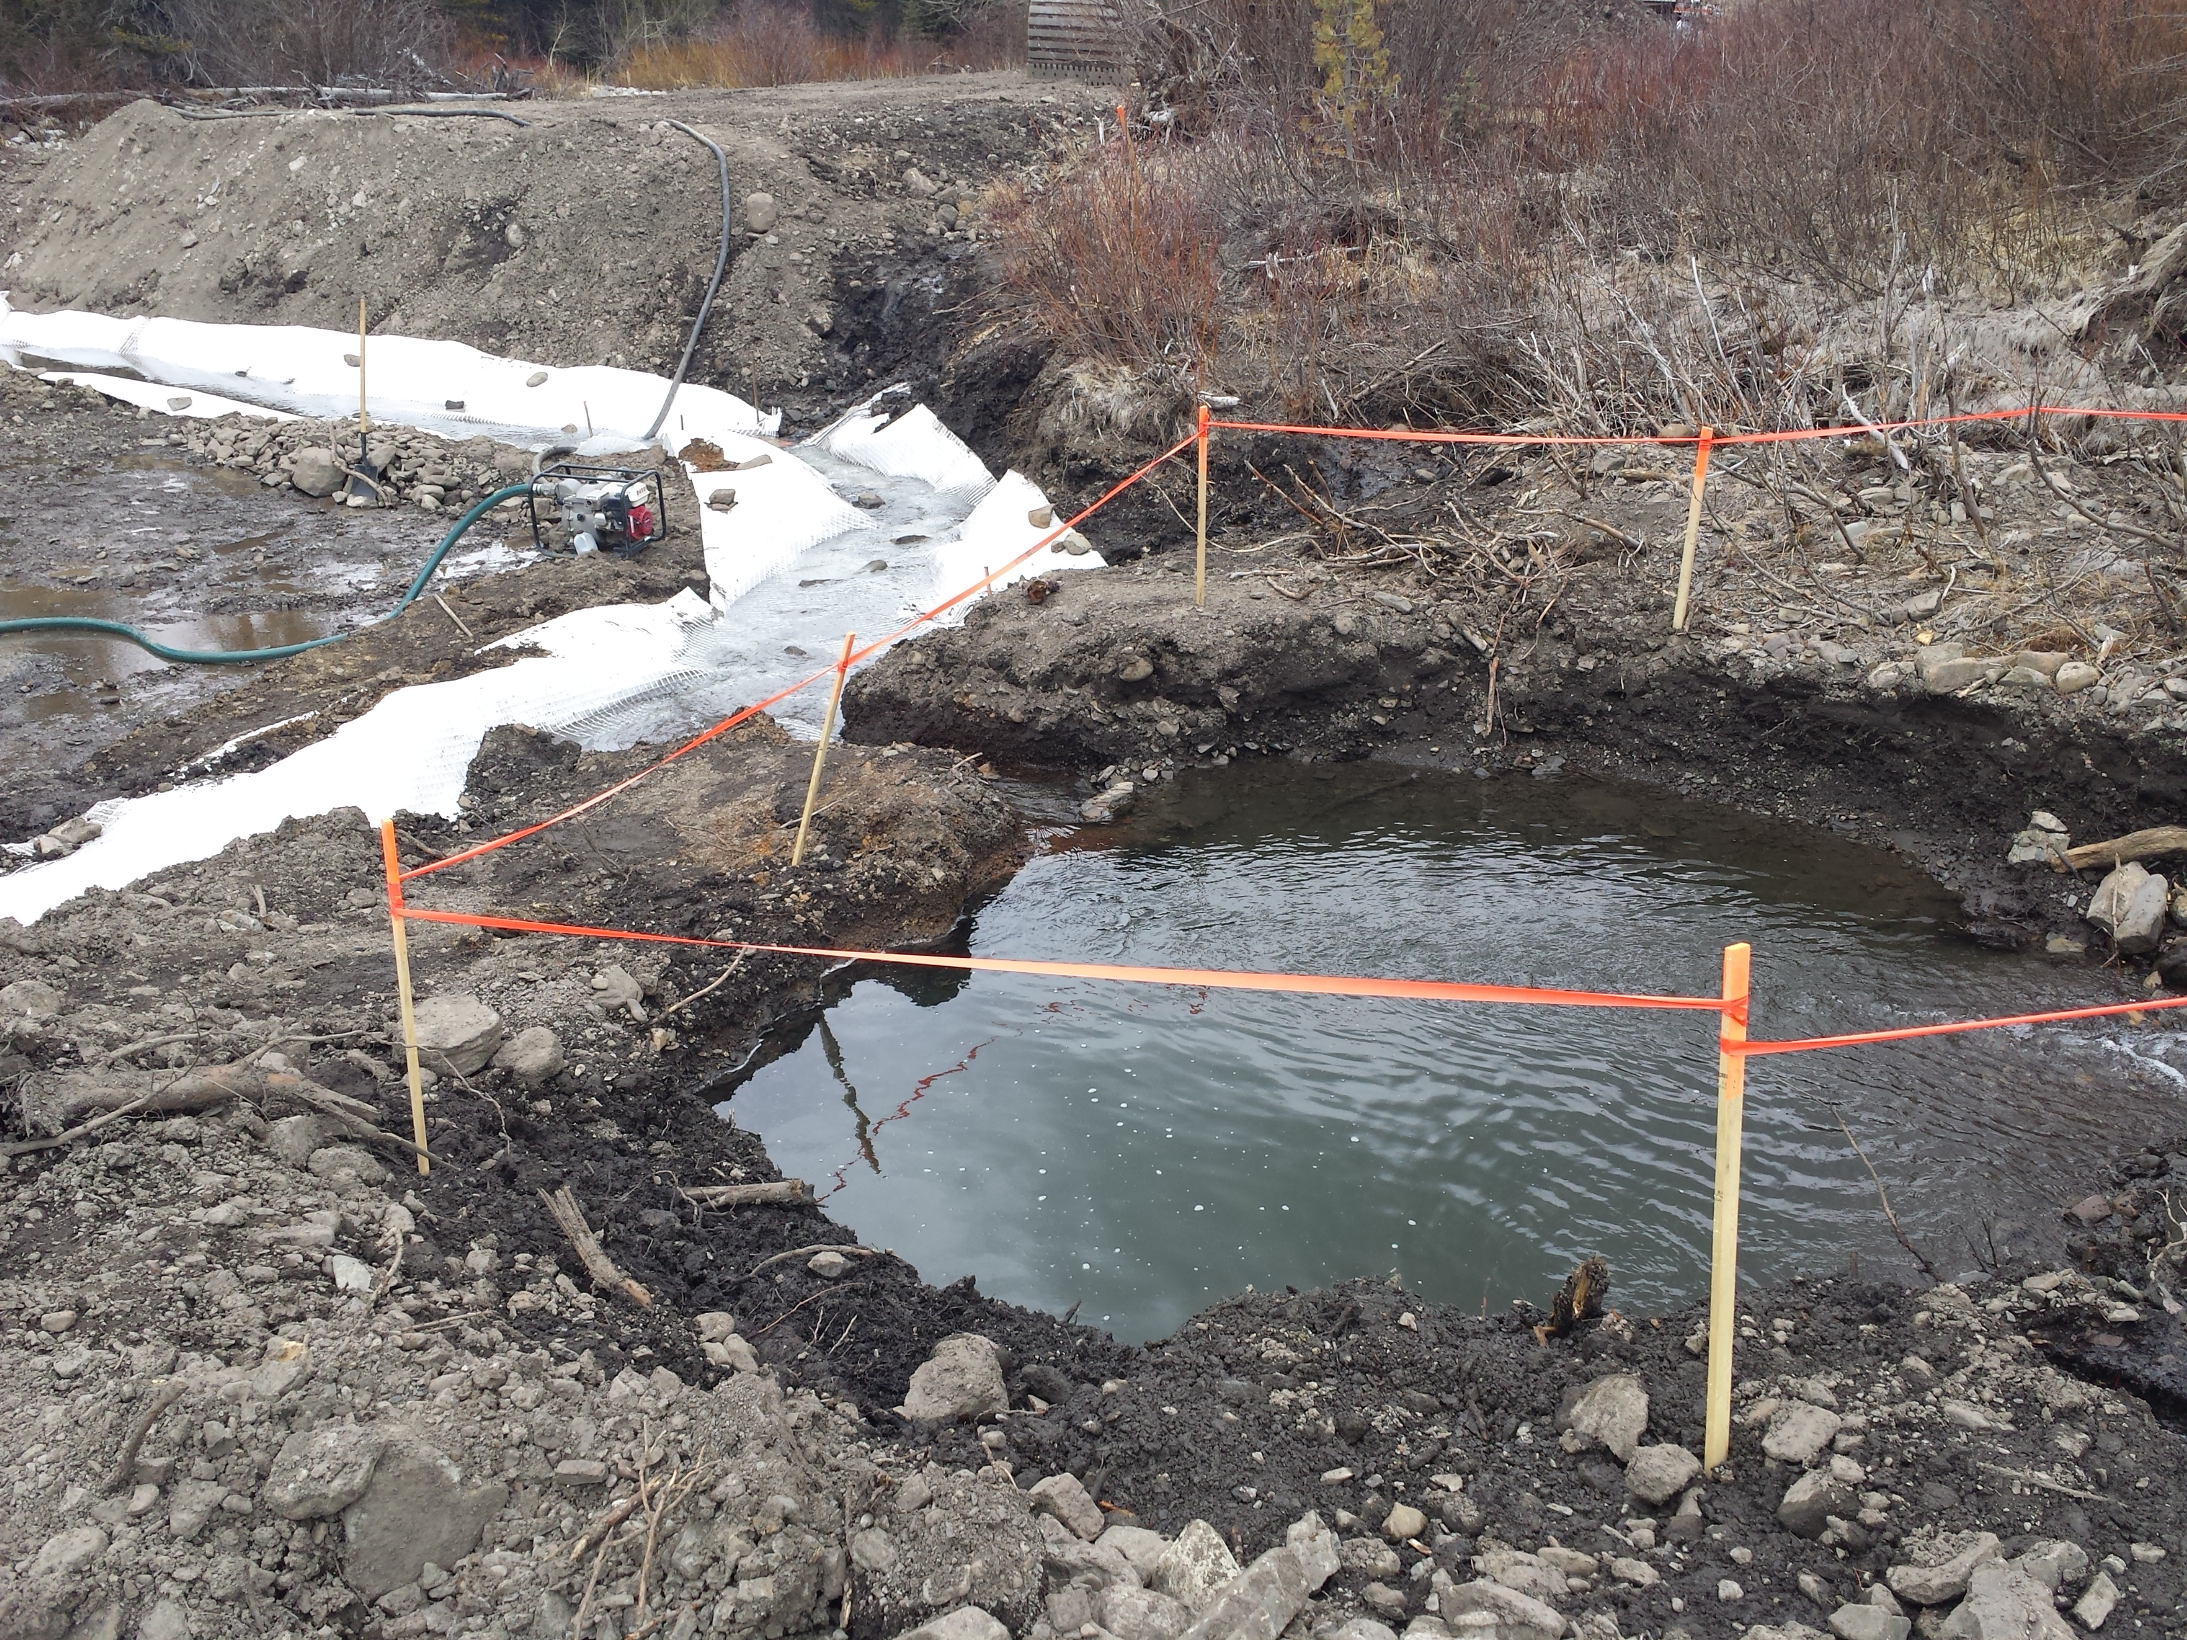
Etherington Creek Culvert Replacement

Slide 14
Etherington Creek Culvert Replacement
Tremendous water control challenges
Environmental shut downs
Technical challenges
We worked with the Contractor rather than trying to be the “specification police”
Although there was a Extra Work item for control of excessive ground water, there would have been excessive costs if we had not proactively worked with the Contractor.

Slide 15
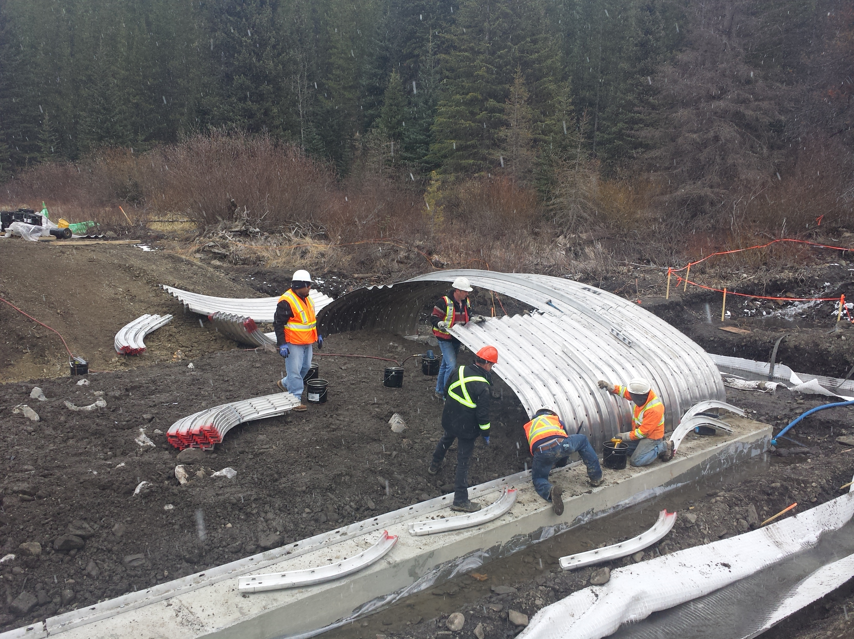
Etherington Creek Culvert Replacement

Slide 16
Etherington Creek Culvert Replacement
This type of structure could be built anywhere a bridge is being considered
The structural ribs make it a rigid structure
Tendered price was about 25% lower than equivalent bridge

Slide 17
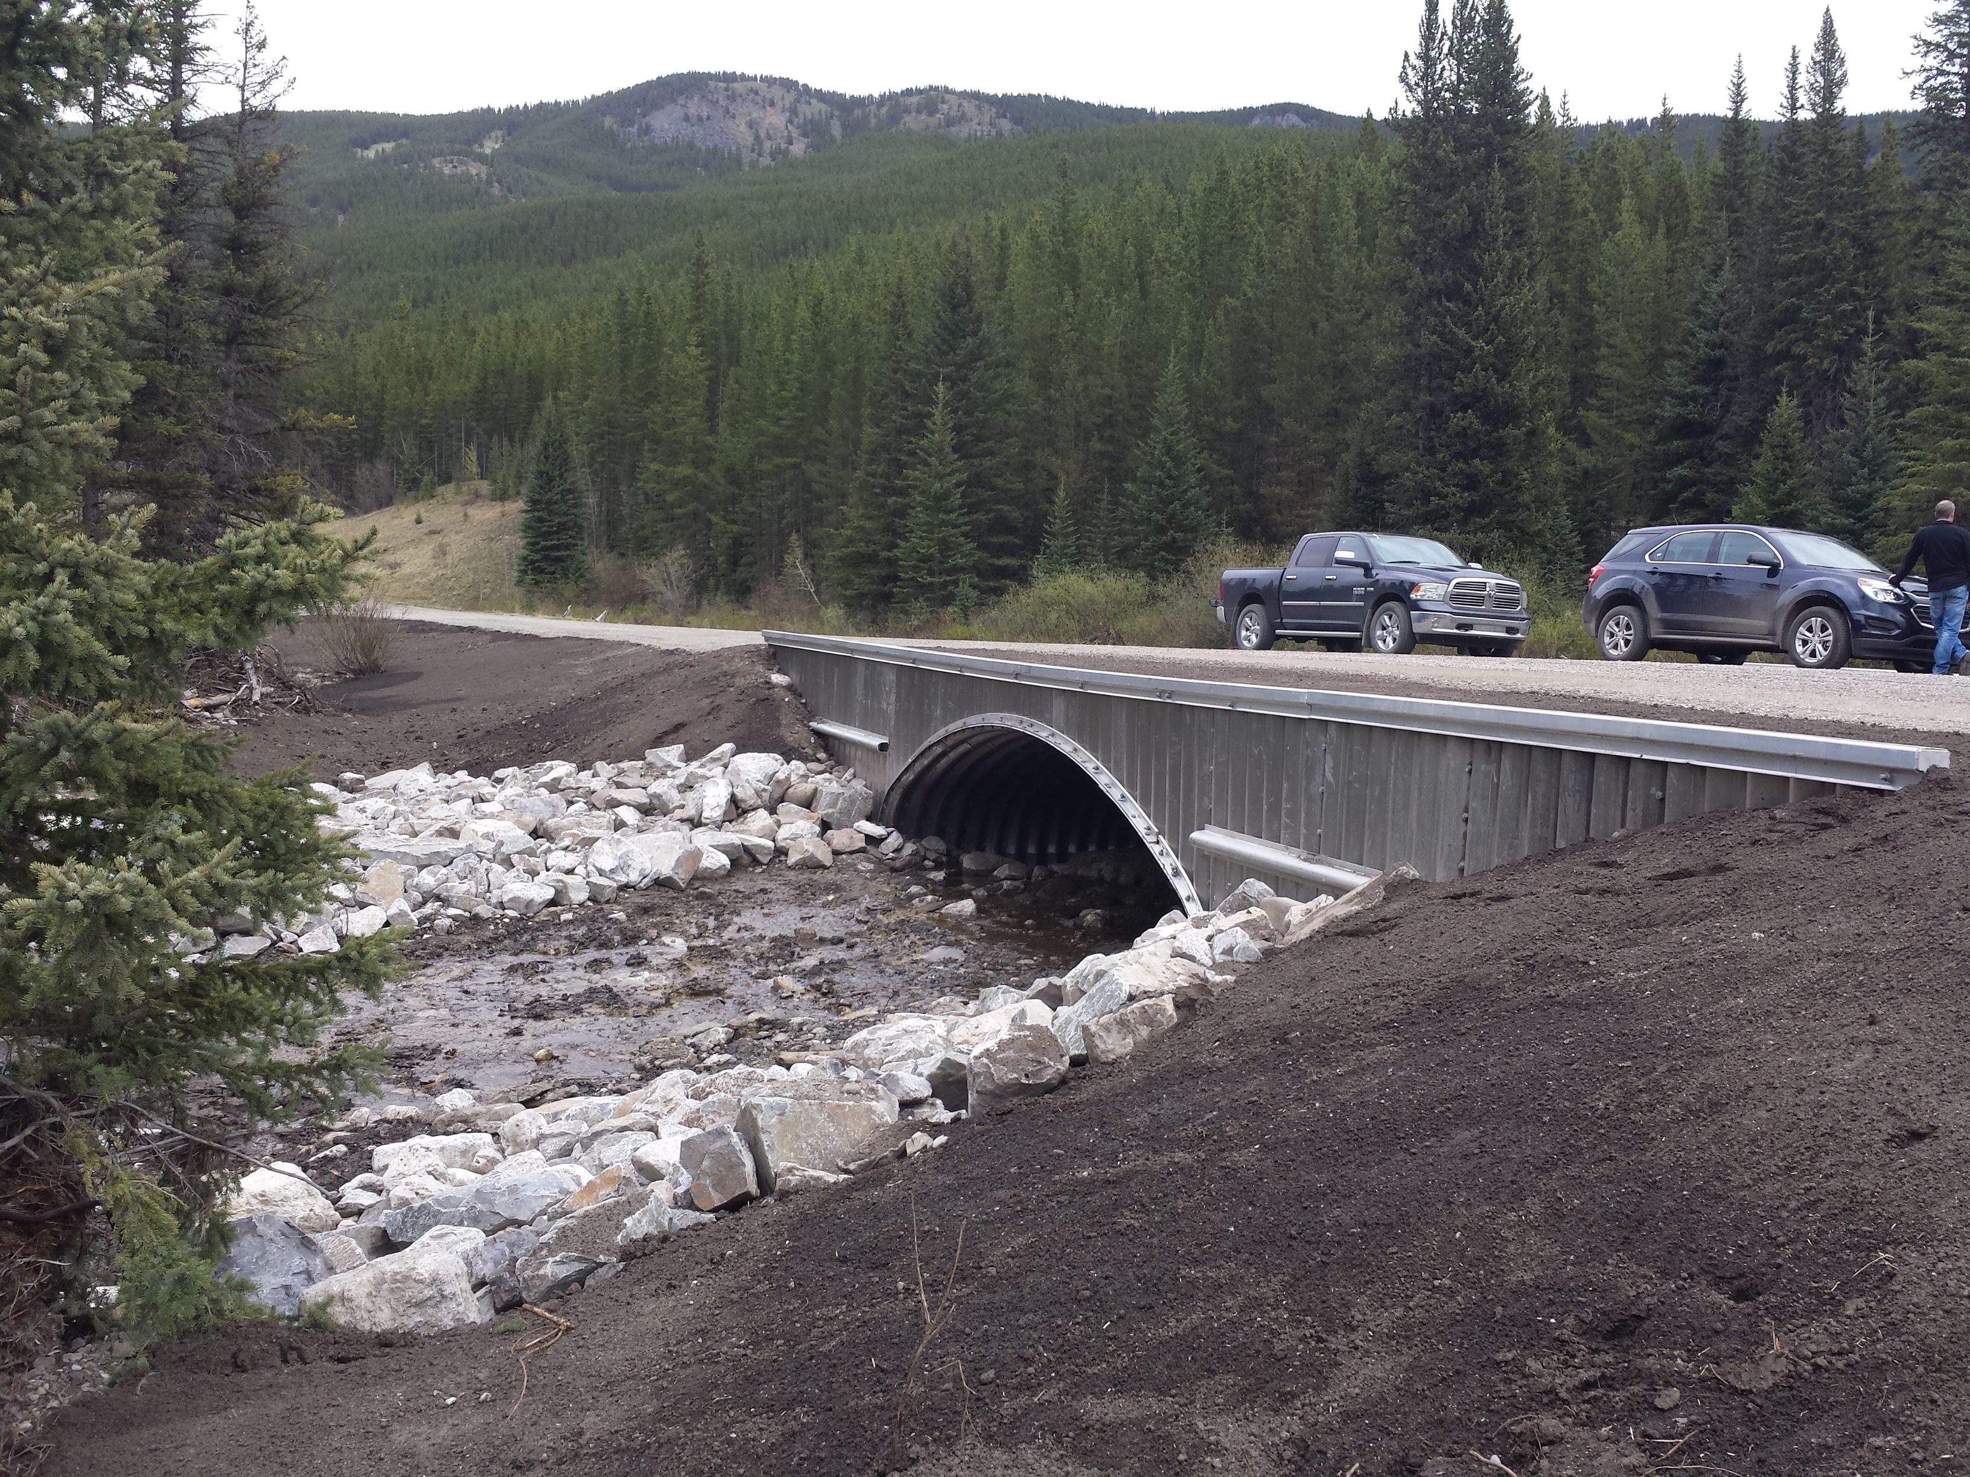
Etherington Creek Culvert Replacement

Slide 18
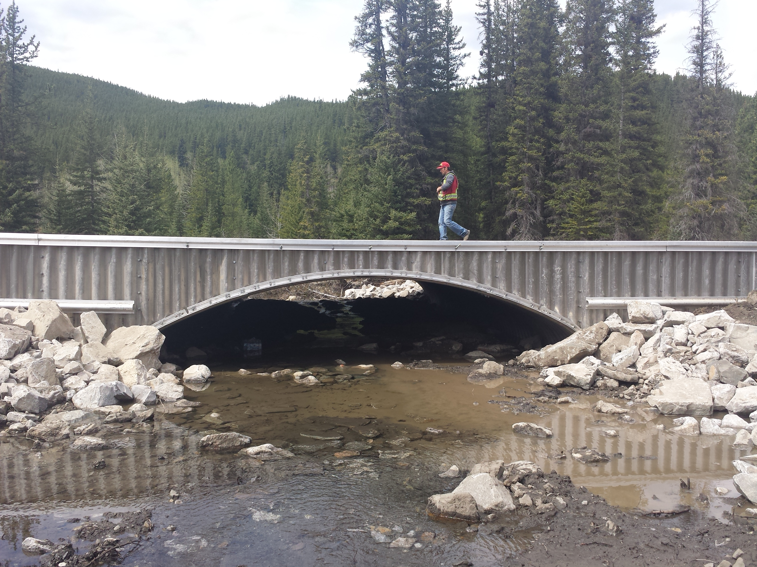
Etherington Creek Culvert Replacement

Slide 19
Summary
Our promise is that we will manage your projects to the highest standards, while doing our part to build the relationships, both with you as well as the Contractors that work in your County/M.D.

Slide 20
Bernie Roseke, P.Eng., PMP
President
Roseke Engineering Ltd.

