Slide 1
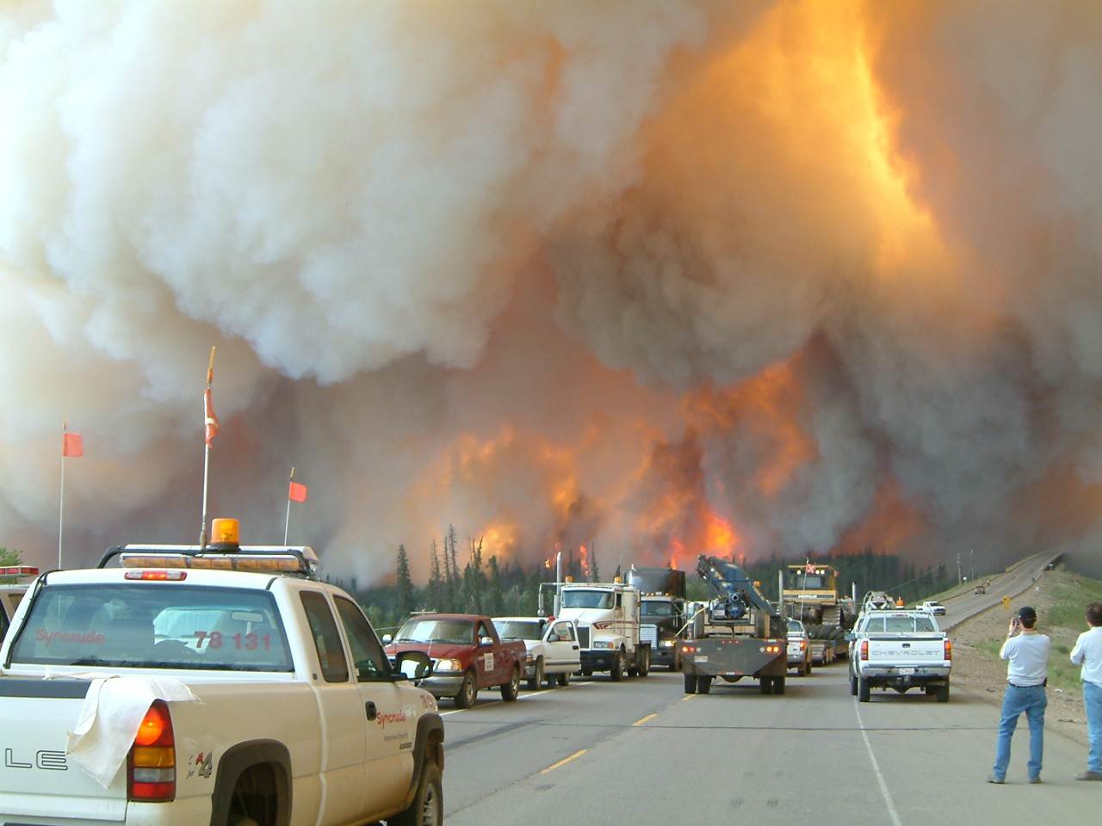
The Alberta Emergency Management Agency
Alan Younghusband
Manager, Training, Certification and Standards

Slide 2
AEMA Mission
To provide strategic leadership to the Government of Alberta in the fields of emergency management and business continuity, and collaborate with emergency management partners and stakeholders in order to build a safer, more disaster-resilient Alberta.
Notes:
As part of the Ministry of Public Safety and Emergency Services, the Alberta Emergency Management Agency (AEMA) will provide strategic leadership to the GoA in the fields of emergency management and business continuity, and collaborate with emergency management partners and stakeholders in order to build a safer, more disaster- resilient Alberta.
AEMA does this by leading the coordination, collaboration and co-operation of all organizations involved in the prevention, preparedness, response and recovery for disasters and emergencies.
AEMA has the overarching objectives of:
Protecting Lives
Protecting Property
Protecting the Environment
Protecting the Economy.

Slide 3
AEMA – Agency Composition
AEMA Managing Director’s Office
Provincial Operations Branch
Recovery Branch
Strategy and System Supports Branch
Notes:
Policy – Acts/Regulations
HIRA – Risk Assessment – launch in 2024
AFRRCS
Personal Preparedness Program
Fin
Fleet Support

Slide 4
AEMA – Agency Composition
AEMA Managing Director’s Office
Provincial Operations Branch
Recovery Branch
Strategy and System Supports Branch
Notes:
MWAP
DRP
Municipal / Private Industry

Slide 5
AEMA – Agency Composition
AEMA Managing Director’s Office
Provincial Operations Branch
Recovery Branch
Strategy and System Supports Branch
Notes:
Describe generally what the different branches do in AEMA to situate the discussion on our role, and relationship with the community of practice in EM in Alberta.

Slide 6
AEMA Provincial Operations Branch - Composition
Executive Director, Provincial Operations
Field Operations
Central Operations
Regional Field (Incl WUI)
First Nations Field
Training, Certification and Standards
Planning
ESS
PECC & Watch Station
Public Alerting, Communications and Training (PACT)
Advising on coordination, maintenance and quality of EM programs at the local level
Advising on coordination and preparations at the intergovernmental and interagency level
Notes:
Describe, generally, difference between two sides of the branch and the units/program areas.

Slide 7
Central Operations
Emergency Social Service (ESS)
Planning Section (Plans)
Provincial Emergency Coordination Centre
Public Alerting, Communication and Training (PACT)

Slide 8
Emergency Social Services
Day to Day
In community:
Support Local Authority (LA) to develop their ESS program
Develop and deliver resources supporting consistent ESS across the province, including training and education
LA ESS Plan reviews and support
Provide mentorship and support for ESS components of exercises
In Government:
Coordinate GoA programs needed to support ESS delivery
Represent ESS in projects, committees, with other ministries etc.
During Activation
Coordination and Collaboration with local Governments, Agencies and NGOs in the provision of ESS Supports and Services
Provide support to hosting and impacted communities, including deployment off PESS personal
Registration and Reception Centre Program (RRCP)
Coordinate GoA resources from the PECC needed to support ESS.
Currently a standing Branch of the Operations Section

Slide 9
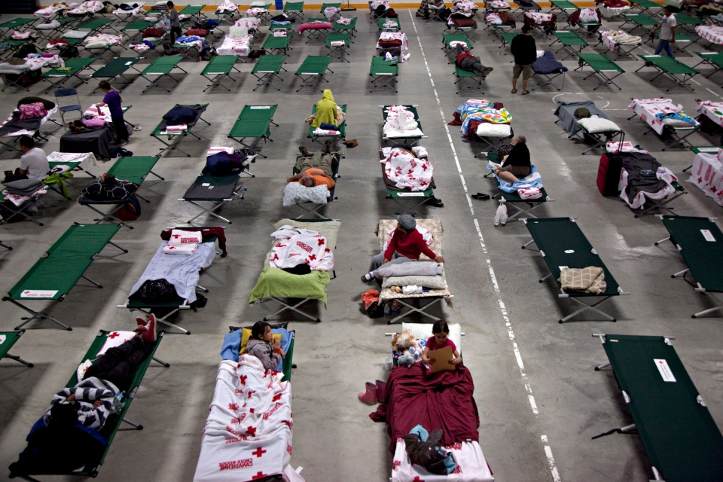
Emergency Social Services
Provincial Emergency Social Services (PESS) is the provincial-level support to local communities (e.g., municipalities, districts, Metis settlement, special areas, etc.) in dealing with the human impact of emergency and disasters. PESS also supports First Nations as requested.
PESS assists local ESS staff/volunteers and leadership coordinate the delivery of ESS services and supports in all the phases of Emergency Management.
The Human Element of Disaster and Emergency

Slide 10
Plans
Mandate
Collects, analyses and evaluates information relating to the incident in order to identify what actions are likely to be required in the near term or future in order for the PECC Incident Commander to set objectives
Assist PECC Incident Commander with regards to business continuity issues and the Cross Government Coordination Team
How does it work?
Coordinate and conduct the planning process (current /future/contingency)
Deliberate planning
Use of subject matter experts/representatives (CMOs/BCOs from GOA departments)
Notes:
Ideally, the Plans section worries about what is going to happen next.
- 24 to 72 hours (or more!) is our jam.

Slide 11
PECC
Always
Provides 24/7/365 monitoring of the Province of Alberta;
Collation and synthesis of information;
Application of judgement; and
Report out to stakeholders.
Sometimes (Activation Levels 2-4) – Coordination
Request in;
Sourcing / Procurement
Dispatch; and
Payment.
Rarely (Level 4 and only under State of Emergency) – Control
Direction; and
Approval of local decisions.
Notes:
The PECC through the Watchstation is always at Activation Level 1 – Routine. This provides 24/7/365 monitoring of events to determine impacts or potential impacts to Alberta and/or Albertans.
The Provincial Duty Officers analyze incoming information, collate it, synthesize it, and provide recommendations to the management and executive teams.
Utilizing their judgement and initiative information may be pushed out to stakeholders to help build overall situational awareness.
During PECC Activation Levels 2-4 the PECC acts in an coordination role to enable success for the Lead Organization and Supporting Organizations.
The Province of Alberta has only had 3 Provincial States of Emergency - The 2013 Southern Alberta Floods, the 2016 Fort McMurray Wildfire, the 2023 Alberta Spring Wildfires
On these occasions AEMA on behalf of the Government of Alberta becomes the lead organization instead of being the coordinating organization.

Slide 12
Public Alerting and Communications Team (PACT)
The PACT is comprised of the Alberta Emergency Alert program and Incident Management System.
In addition, they are responsible for the Emergency Management Information System (EMIS) and Provincial Stakeholder Notification System (PSNS).
During activations the PACT Team fills the role of Information Officer and the AEA Coordinator.

Slide 13
AEMA Provincial Operations Branch - Composition
Executive Director, Provincial Operations
Field Operations
Central Operations
Planning
PESS
PECC & Watch Station
Public Alerting, Communications and Training (PACT)
Regional Field (Incl WUI)
First Nations Field
Training, Certification and Standards
Advising on coordination, maintenance and quality of EM programs at the local level
Advising on coordination and preparations at the intergovernmental and interagency level
Notes:
Describe, generally, difference between two sides of the branch and the units/program areas.

Slide 14
AEMA Field Operations - Composition
Director, Field Operations*
Regional Field Operations Unit
First Nations Field Operations Unit
Training, Cert, and Standards Unit
14 Regional Field Officers (Pending new hires)
3 Wildland Urban Interface Field Officers
2 Manager, Regional Field Ops
1 Field Ops Coordinator
4 First Nations Field Officers
1 Admin Support
1 Coordinator
Manager, First Nations Field Ops
1 EM Education Designer
1 Senior ICS Consultant
2 Collective Training Field Officers (AHIMT Initiative)
2 Program / Education Specialists
Manager, TC&S
2 Standards Field Officers (Pending new hires)
Notes:
Explain Field Ops units in detail…
Mention that there are a few “dotted lines” as well i.e. CEMP coord and Field Coord reporting directly to Director.

Slide 15
Field Operations
First Nations Field
Has 4 Field Officers that liaise with 4 First Nations regions
Regional Field
Has 13 Field Officers that liaise with 7 regions
3 Wildland Urban Interface Officers for the province
Training, Certification and Standards
Notes:
Field Operations is the public face of AEMA.
When disaster strikes, Field Officers are the primary point of contact for communities throughout the province and are trained to provide advice and guidance to municipal Directors of Emergency Management. They liaise between the PECC and the Communities during events and provide detailed situation reports to the PECC.
Field Operations also delivers training and emergency expertise to municipal elected officials and regional All-Hazard Incident Management Teams.
Field Officers also assist communities when there is a need to declare a State of Local Emergency or where an Alberta Emergency Alert is required.

Slide 16
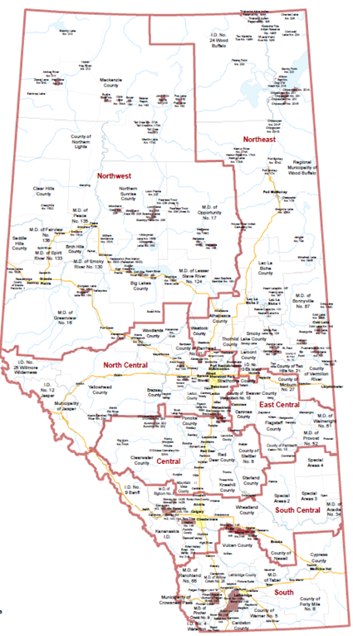
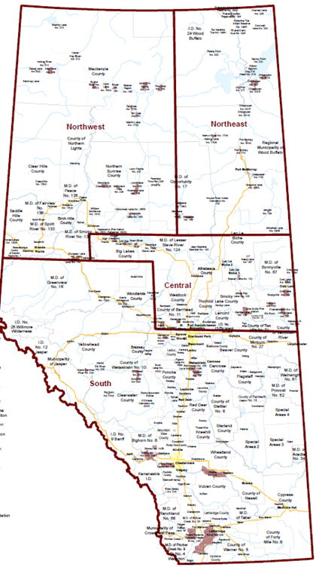
Field Operations
31,000 kms of Highway
Cities – 17
Towns – 108
Villages – 95
Summer Villages – 51
Municipal Districts – 64
FN Communities - 45
Notes:
As you can see on this slide our field officers are very, very busy. The 16 Field Officers are located throughout the province in 7 geographic regions and 3 First Nation Regions.
Due the size of the province and the resulting distance between the communities, AEMA Field Officers have travelled over 650,000 kms so far this year, on Alberta roads, in service to Albertans.
During the 2013 floods we had approximately a dozen Field Officers deployed to southern Alberta. I know, 12 of 16 doesn’t sound like very many, but in 2013 we only had 9 Field Officers, not 16, in a tremendous show of dedication to Albertans, a few came out of retirement to provide assistance.
During the Fort McMurray Wildfires in 2016, initially 8 Field Officers were directly or indirectly engaged in the RMWB. Due to the duration of the incident other FO were used to relieve those in RMWB and to maintain coverage over the rest of the province.

Slide 17
Training, Certification and Standards
AEMA is the Authority Having Jurisdiction (AHJ) for EM in Alberta
AEMA Proprietary Courses
Incident Command Courses
Number Series Courses
Position Specific Courses
Collective Training

Slide 18
All-Hazards Incident Management Teams
Builds Capacity
Regionally
Local Level

Slide 19
Questions?

