Slide 1
Damage Prevention Legislation for Alberta
Mike Sullivan
President – Utility Safety Partners

Slide 2
Damage Prevention Legislation for Alberta
The Memo
The 1970s oil and gas boom in Alberta resulted in an unprecedented number of damages and near hits on Canadian Western Natural Gas (now ATCO) facilities planting the seed for a One-Call Notification System in the province.

Slide 3
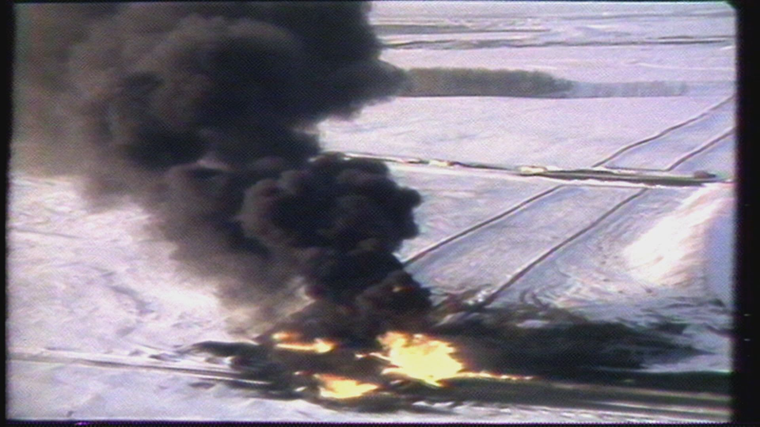
Damage Prevention Legislation for Alberta
The Catalyst
March 2, 1979 – Mill Woods, Alberta
A glass delivery truck driven by Peter Clark passes through a foggy mist migrating across a road. The mist ignites engulfing the vehicle and Mr. Clark sustains lifelong injuries.
The gas migrates into ditches, sewer systems and basements.
18,000 people are evacuated.

Slide 4
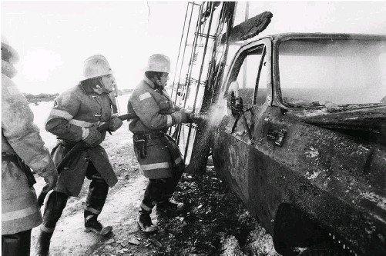
Damage Prevention Legislation for Alberta
The Cause
A nearby pipeline transporting propane had previously been damaged by heavy equipment. Forensic analysis indicated a crude repair was attempted but never reported. Over time, the integrity of the steel diminished and the pipeline ruptured releasing propane – a heavier than air gas – that migrated to the road where Peter Clark’s vehicle intersected and ignited it.

Slide 5
Damage Prevention Legislation for Alberta
Alberta’s Damage Prevention History
1982 – Alberta One-Call Location Corporation is Incorporated
1984 - first locate request received October
1994 - One Millionth Locate Request processed
2004 – Alberta Utility Location Coordination Council becomes Regional Partner of the Common Ground Alliance in Alberta
2004 – Three Millionth Locate Request processed
2005 – Alberta Pipeline Regulation mandates registration with AOC
2014 – AOC creates ClickBeforeYouDig.com website
2015 – AOC initiates ClickBeforeYouDig Trademark application

Slide 6
Damage Prevention Legislation for Alberta
Alberta’s Damage Prevention History
2019 – AOC initiates mandatory web requests for Contractors and Members
2019 – AOC and ABCGA Boards of Directors agree with recommendation to unify services
2020 – AOC Board of Directors revises mandate to include damage prevention to overhead energy and utility assets (Where’s the LINE? campaign)
2020 - AOC is ISO 9001 Certified
2021 – AOC rebrands to Utility Safety Partners

Slide 7
Damage Prevention Legislation for Alberta
Unifying Damage Prevention Services

Slide 8
Damage Prevention Legislation for Alberta
Unifying Damage Prevention Services

Slide 9
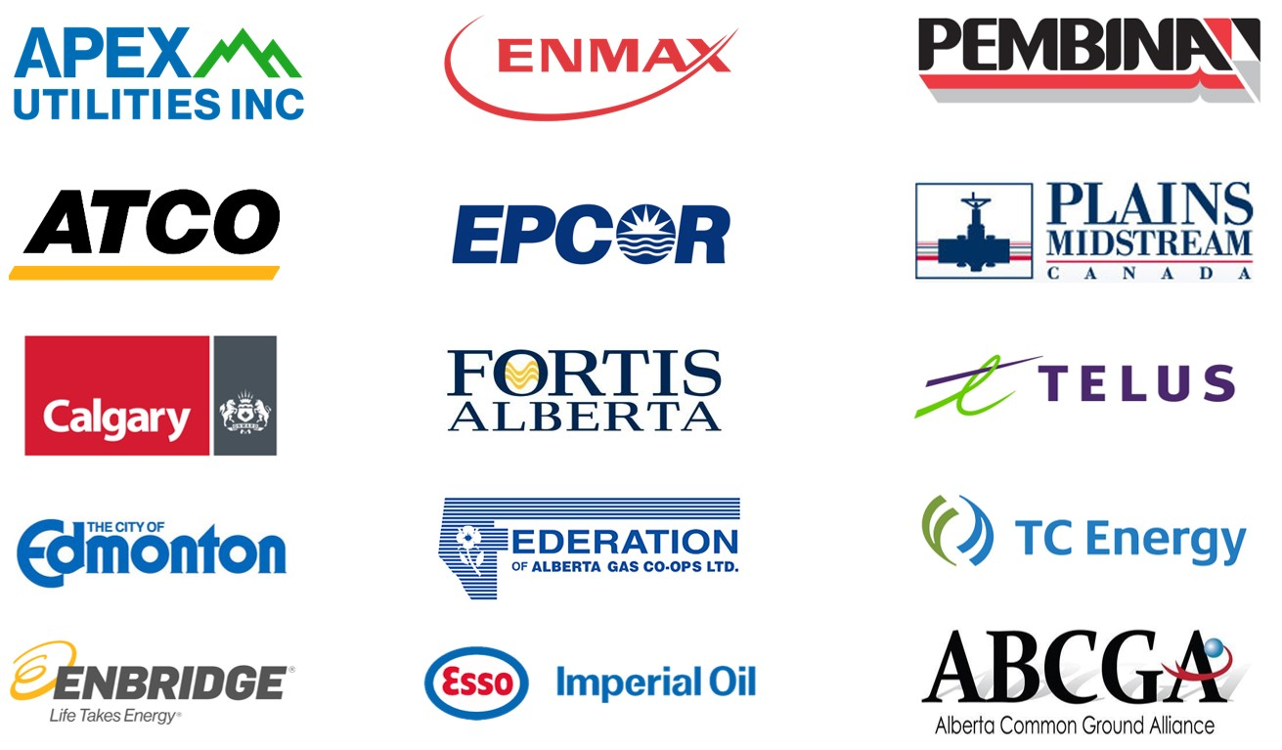
Damage Prevention Legislation for Alberta
Utility Safety Partners Governance

Slide 10
Damage Prevention Legislation for Alberta
The Damage Prevention Process
Click or Call Before You Dig
~ 450,000 locate requests/yr
(87% are “Clicks”)
Request is Auto-Processed
Members with Assets in the digging area are notified and must respond

Slide 11
Damage Prevention Legislation for Alberta
Benefits of Registering Energy & Utility Assets
One System / One Approach to initiate the damage prevention process with our Best in Class system
Reduce utility damages, their consequences and societal costs
Demonstration of due diligence
Enhanced cooperation among safety stakeholders toward the achievement of common goals
Opportunity to standardize methods and procedures
Economies of scale and consistency of messages in advertising and public awareness programs
Participate in committees that influence the future of damage prevention
Contribute to the development of consensus positions
Have a voice in the process, share information, and network with peers

Slide 12
Damage Prevention Legislation for Alberta
Cost of Damage
2021
Average of 15.2 damages to buried energy and utility assets every day.
Cost to repair damaged infrastructure
Service disruption
Deployment of emergency services
Evacuation
Loss of product
Environmental impact and mitigation
Economic impact
Work delays
Administrative and legal costs
Estimated societal costs in Alberta: $350 Million.

Slide 13
Damage Prevention Legislation for Alberta
Damage Reporting and Best Practices
Utility Safety Partners is a member of the Canadian Common Ground Alliance. The CCGA produces the annual Damage Information and Reporting Tool (DIRT) Report identifying root causes of damage.
USP is proposing mandatory damage reporting within legislation to determine root causes. The damage reporting function is anonymous and not intended to lay blame. Rather, it is designed to develop methods and best practices to prevent a recurrence.

Slide 14
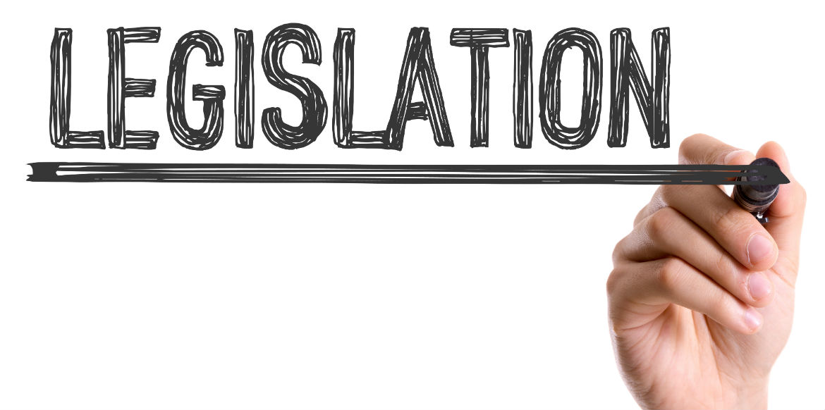
Damage Prevention Legislation for Alberta
Current Legislation in Alberta
2005 - Provincially regulated transmission pipelines must be registered with USP
2016 – Federally regulated transmission pipelines must be registered with USP
Proposed:
All buried and aboveground energy and utilities within a public right of way must register with USP.
Every person conducting a ground disturbance must request a locate.
Every utility owner notified of a ground disturbance must respond.

Slide 15
Damage Prevention Legislation for Alberta
Seed Documents

Slide 16
Damage Prevention Legislation for Alberta
Engagement with Alberta Municipalities and Rural Municipalities
ABCGA Government Relations portfolio needed to be maintained under new unified services
USP developed a Government Relations Committee, released RFP for a Government Relations Consultant and hired Concentric Public Affairs
USP re-initiates relationship with United Conservative Party Member of the Legislative Assembly

Slide 17
Damage Prevention Legislation for Alberta
Municipal Members Registered with USP
Voluntary Registration
Registered
Not registered

Slide 18
Damage Prevention Legislation for Alberta
Facilitating Municipal Registration with USP
USP proposes 5-year grace period for municipalities to register buried and aboveground energy and utility assets with USP (Ontario legislation provided municipalities with 2-year grace period).
Until the location of municipal energy and utility assets have been identified, USP will notify the municipality of any ground disturbance occurring within its boundaries.
Once the location of municipal energy and utility assets have been identified, notifications of proposed ground disturbances will diminish as they will be in relation to shape files / polygon data submitted to USP.

Slide 19
Damage Prevention Legislation for Alberta
Onboarding Process
Members provide data to USP’s Member Services Team
Member Services uploads data onto USP base map
Uploaded data is returned to new member for final verification
Once the data / base map is confirmed, the member’s data goes live on the system

Slide 20
Damage Prevention Legislation for Alberta
Engagement & Transparency

Slide 21
Damage Prevention Legislation for Alberta
Engagement & Transparency

Slide 22
Damage Prevention Legislation for Alberta
Engagement & Transparency

Slide 23
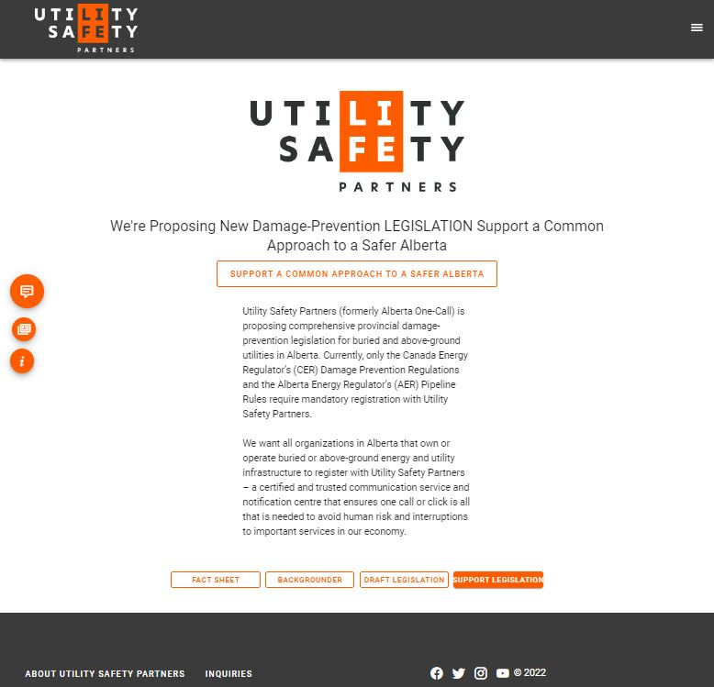
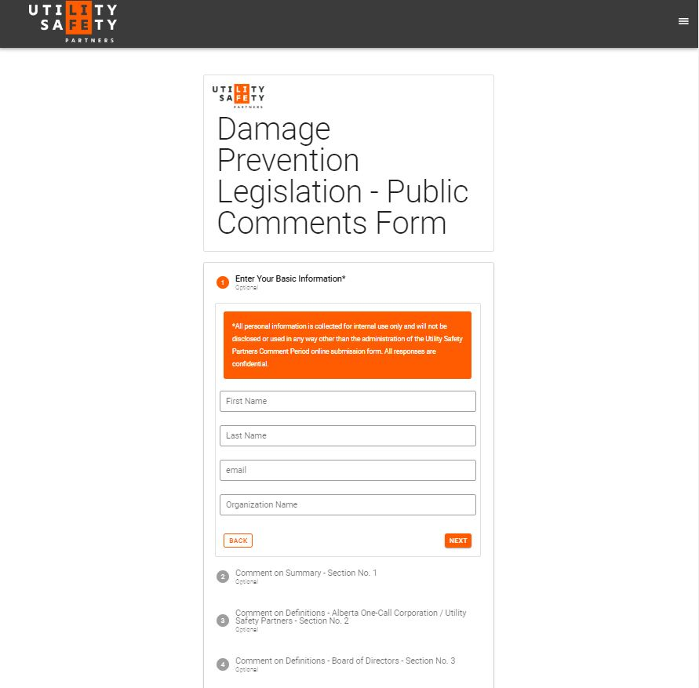
Damage Prevention Legislation for Alberta
Engagement & Transparency

Slide 24
Damage Prevention Legislation for Alberta

