Slide 1
AMSA Update
November 8, 2022

Slide 2
WHY ARE WE HERE
Year in Review- Canoe’s inaugural year
Canadian Procurement update its changing landscape
Supply Chain
SUPPLIER SUMMIT

Slide 3
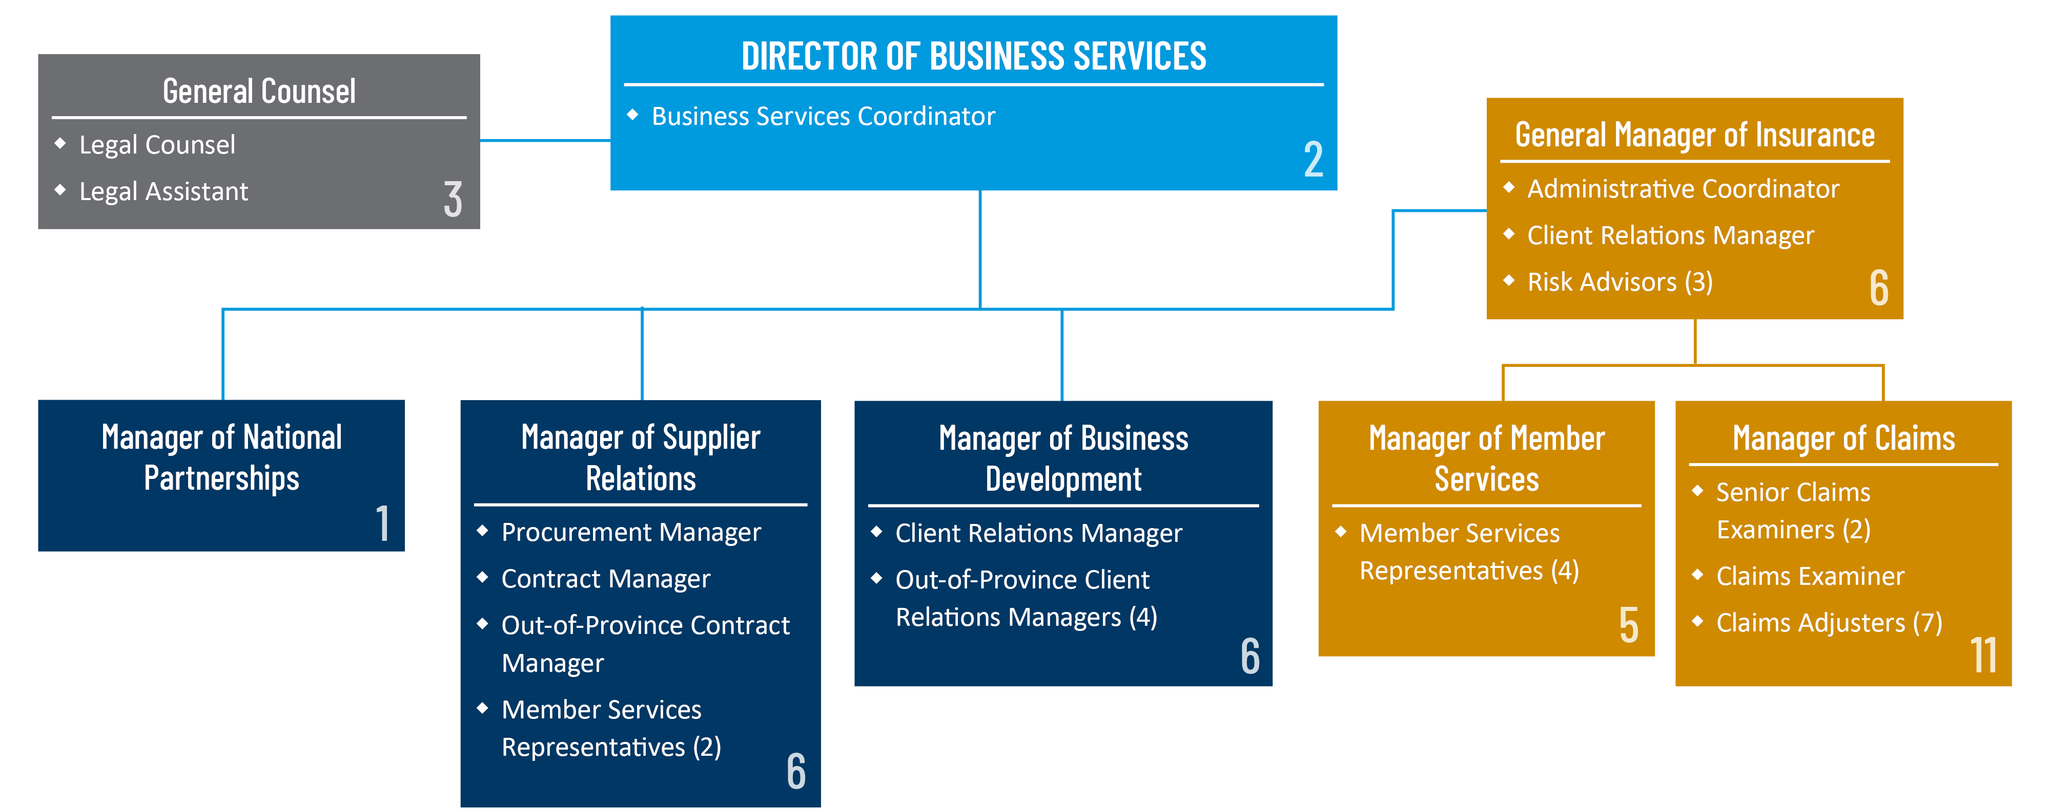
CANOE ORGANIZATIONAL CHART
SUPPLIER SUMMMIT

Slide 4
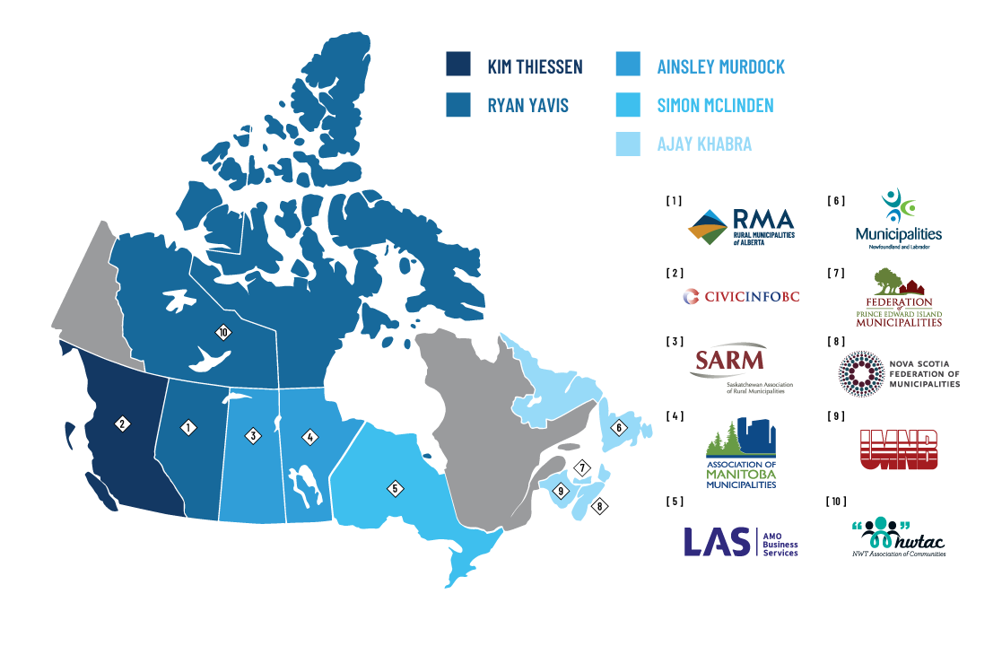
CANOE TRADE AREAS
SUPPLIER SUMMMIT

Slide 5
Canoe Capital spend FY 14/15 – 21/22 (USD)
Canoe & Insurance Team Meeting

Slide 6
GOVERNEMENTAL PROCUREMENT- What are they saying
Supply chain issues
Increased pricing- even after time of order
Huge push to shop pricing and buy local
Labour shortage
Silver Wave of Retirement
SUPPLIER SUMMIT

Slide 7
GOVERNEMENTAL PROCUREMENT- AN EVOLVING LANDSCAPE
As Canoe’s reach has grown so has the scrutiny by our membership
They are demanding more information- and rightful so!
Provincial governments have pushed toward local buying
Centralized programs and the single point of access
SUPPLIER SUMMIT

Slide 8
GOVERNEMENTAL PROCUREMENT- AN EVOLVING LANDSCAPE
Canoe is updating its website
Updates will include RFP documentation, Evaluation and Contract documents
Member and member number csv. Download
More material on the Supplier Hub
SUPPLIER SUMMIT

Slide 9
ESGs AND PROCUREMENT
ESGs or SDGs are being put into the tender process
There is no standardized approach to ESGs
Make sure your supporting reports are easy to access
Quantify your efforts to show real savings or environmental reductions
SUPPLIER SUMMIT

Slide 10
THANK YOU FOR YOUR PARTNERSHIP!
QUESTIONS?

